Slide 1
Incubator Application
Developed By Waleed Abdel-Aziz Ibrahim Mahmoud Hassanin
Job: Assistant Lecture at MTI University in Artificial Intelligence Department till now
Masters from Computer Science at Computer Science at Arab Academy for Science Technology and Maritime Transport

Slide 2
Agenda
Introduction
Problem Definition
Proposed Solution
Main Goal(s)
Features
Ark Work
Navigation Screen (Block Diagram)
Screen Shot (GUI)
Hardware Specification (Mobile device)
Tools
Demo
Future Work

Slide 3
Agenda
Introduction
Problem Definition
Proposed Solution
Main Goal(s)
Features
Ark Work
Navigation Screen (Block Diagram)
Screen Shot (GUI)
Hardware Specification (Mobile device)
Tools
Demo
Future Work

Slide 4
Introduction
Incubator Control System: it is a control system for an intensive care unit for newborn babies who may be premature or suffering from illness, breathing difficulties or other birth complications.
The functionality of the Incubator control system is to monitor and control temperature ,humidity and oxygen inside the incubator :
By creating a closed and controlled environment made by Acrylic Doubled Wall .
the incubator protects the newborn from infection, air drafts and handling by nurses and doctors authorized to work within the neonatal intensive care units (NICU)
Note: this is a demo Workable Application. It can be tested on any mobile Android and IOS devices

Slide 5
Agenda
Introduction
Problem Definition
Proposed Solution
Main Goal(s)
Features
Ark Work
Navigation Screen (Block Diagram)
Screen Shot (GUI)
Hardware Specification (Mobile device)
Tools
Demo
Future Work

Slide 6
Problem Definition
Doctors and nurse team hard manual to follow up data.
Lack of monitoring capabilities.
Parents hard to visit the hospital due to the COVID-19

Slide 7
Agenda
Introduction
Problem Definition
Proposed Solution
Main Goal(s)
Features
Ark Work
Navigation Screen (Block Diagram)
Screen Shot (GUI)
Hardware Specification (Mobile device)
Tools
Demo
Future Work

Slide 8
Proposed Solution
A mobile application to be installed on user’s devices which has authorized to access data in hospital such as (Parents, Doctors, Nurses, Accountant).
A Mobile application helps Parents, who has authorization to access the data, can see the last status of newborn including medical records, bills, and a live camera to see the newborn through the camera that installed in the incubator.
Mobile application helps doctors and nurses to track the medical records of newborn rather than paper work.
Mobile application helps the accountant and patients for calculating the bills.

Slide 9
Agenda
Introduction
Problem Definition
Proposed Solution
Main Goal(s)
Features
Ark Work
Navigation Screen (Block Diagram)
Screen Shot (GUI)
Hardware Specification (Mobile device)
Tools
Demo
Future

Slide 10
Main Goal (S)
Parent can track their newborn medical record
Parent can pay their bills through the app by credit card
Parent can see their newborn by using live camera that connect to the hospital
Doctor and Nurse can easily track the medical record of newborn through the application
Highly Security which parent login in by username and password Or Sign in by Huawei

Slide 11
Agenda
Introduction
Problem Definition
Proposed Solution
Main Goal(s)
Features
Ark Work
Navigation Screen (Block Diagram)
Screen Shot (GUI)
Hardware Specification (Mobile device)
Tools
Demo
Future Work

Slide 12
Features
Sign In / Sign Up
Sign In By Huawei Id (Integrate HMS)

Slide 13
Features (cont.)
Patient view Newborn Medical Records
Latest Status of Newborn
View Laboratory Records
View X-ray Records
View Medical Records
View Consumable Records
View Extra Records
View Bills Records
Pay Bills by Credit Card
Edit Credit Card
View Live to see baby inside the incubator based on appointment

Slide 14
Features (cont.)
Doctor Edit Patient Medical Records
Edit Laboratory Records
Edit X-ray Records
Edit Medical Records
View Consumable Records
Edit Extra Records
Change State of Newborn
Change Condition of Newborn
Change Light Ray of Newborn
Change Incubator of Newborn
View History Status of Newborn

Slide 15
Features (cont.)
Nurse Edit Patient Medical Records
View Laboratory Records
View X-ray Records
View Medical Records
View State of Newborn
View Condition of Newborn
View Light Ray of Newborn
View Incubator of Newborn
Edit Status of Newborn
Edit Consumable Records
Edit Extra Records

Slide 16
Features (cont.)
Accountant Edit Patient Bills Records
Calculate Bills for the Newborn

Slide 17
Agenda
Introduction
Problem Definition
Proposed Solution
Main Goal(s)
Features
Ark Work
Navigation Screen (Block Diagram)
Screen Shot (GUI)
Hardware Specification (Mobile device)
Tools
Demo
Future Work

Slide 18
Agenda
Introduction
Problem Definition
Proposed Solution
Main Goal(s)
Features
Ark Work
Navigation Screen (Block Diagram)
Screen Shot (GUI)
Hardware Specification (Mobile device)
Tools
Demo
Future Work

Slide 19
Navigation Screen
Startup Navigation Screens
Doctor Navigation Screens
Nurse Navigation Screens
Accountant Navigation Screens
Patient Navigation Screens

Slide 20
Navigation Screen
Startup Navigation Screens
Doctor Navigation Screens
Nurse Navigation Screens
Accountant Navigation Screens
Patient Navigation Screens

Slide 21
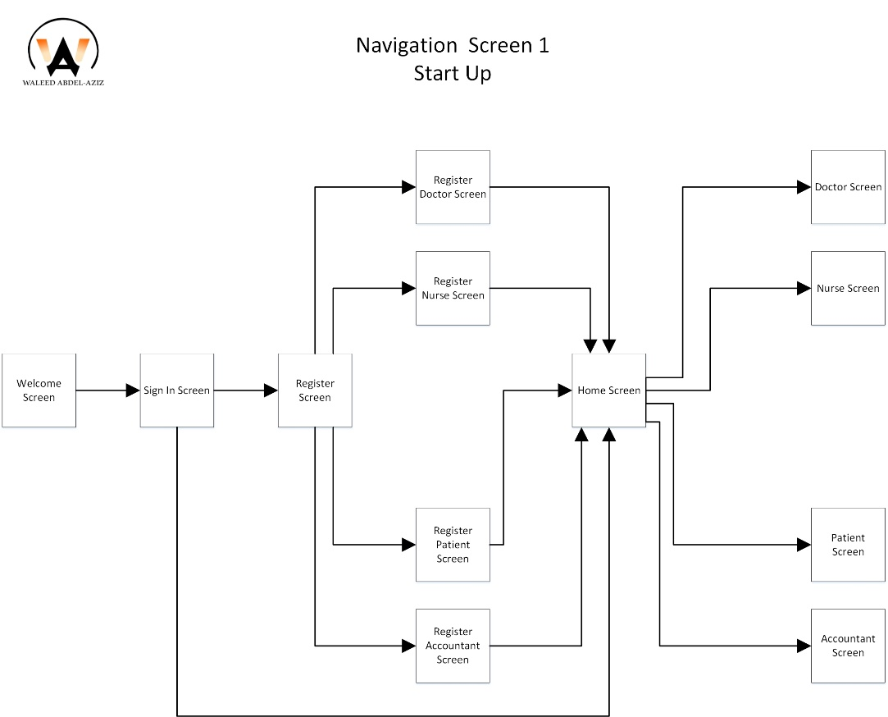
Startup Navigation Screens

Slide 22
Navigation Screen (Block Diagram)
Startup Navigation Screens
Doctor Navigation Screens
Nurse Navigation Screens
Accountant Navigation Screens
Patient Navigation Screens

Slide 23
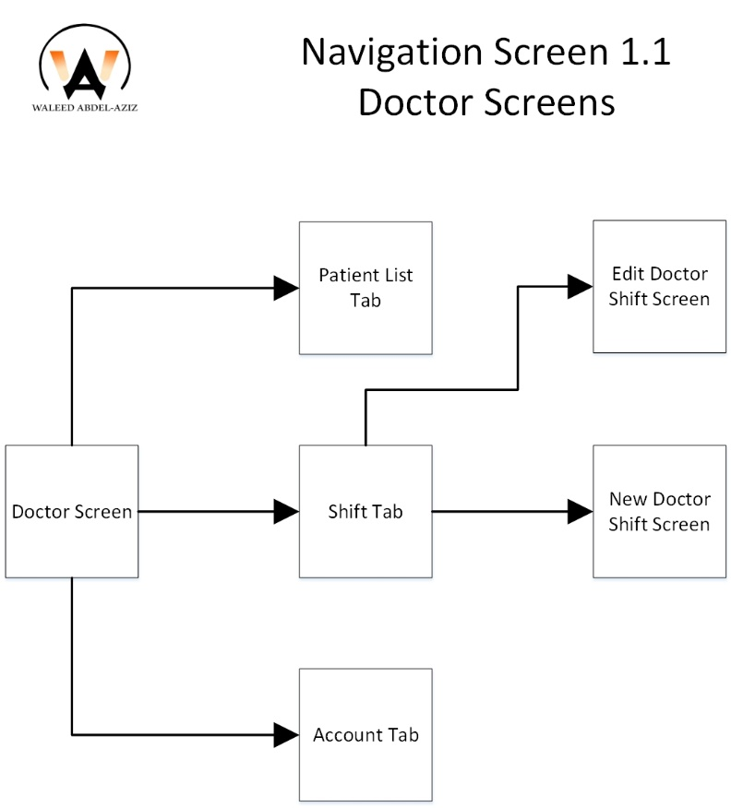
Doctor Navigation Screens

Slide 24
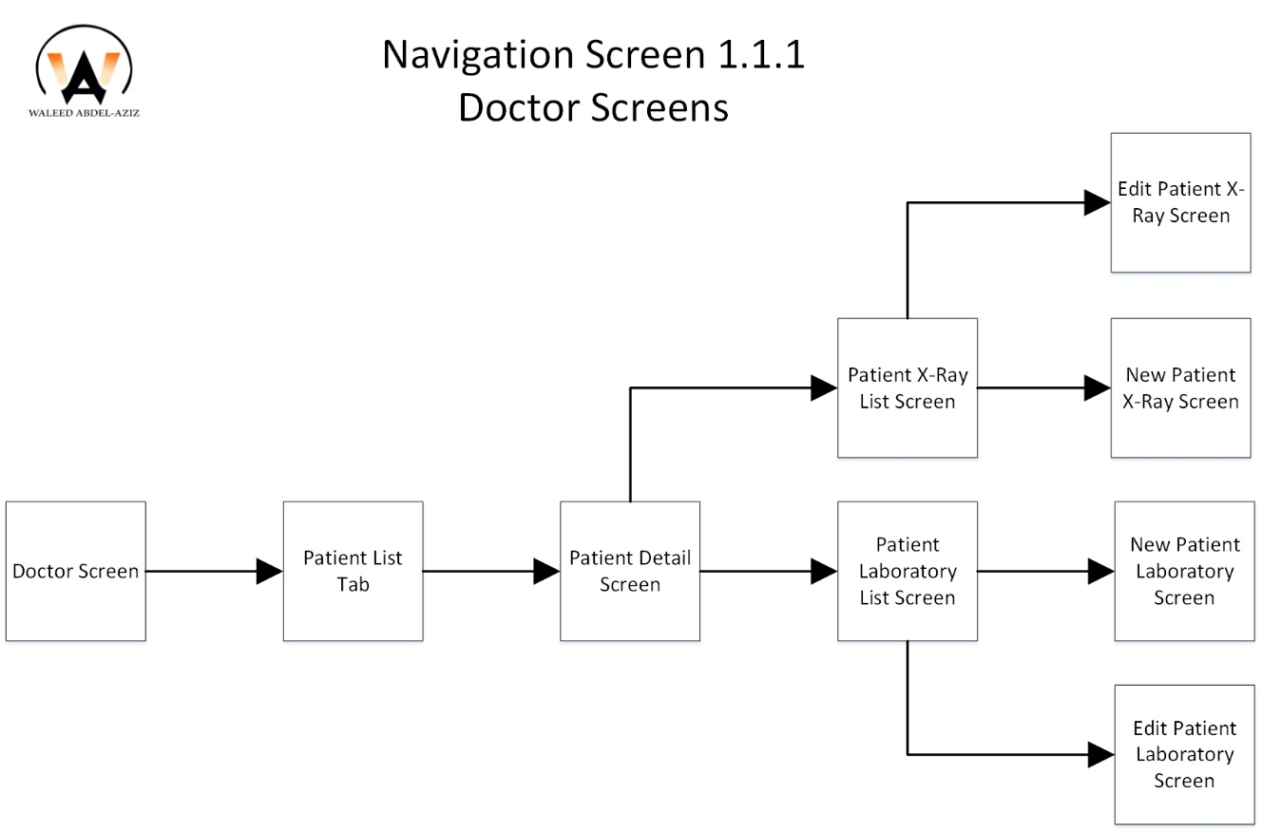
Doctor Navigation Screens (cont.)

Slide 25
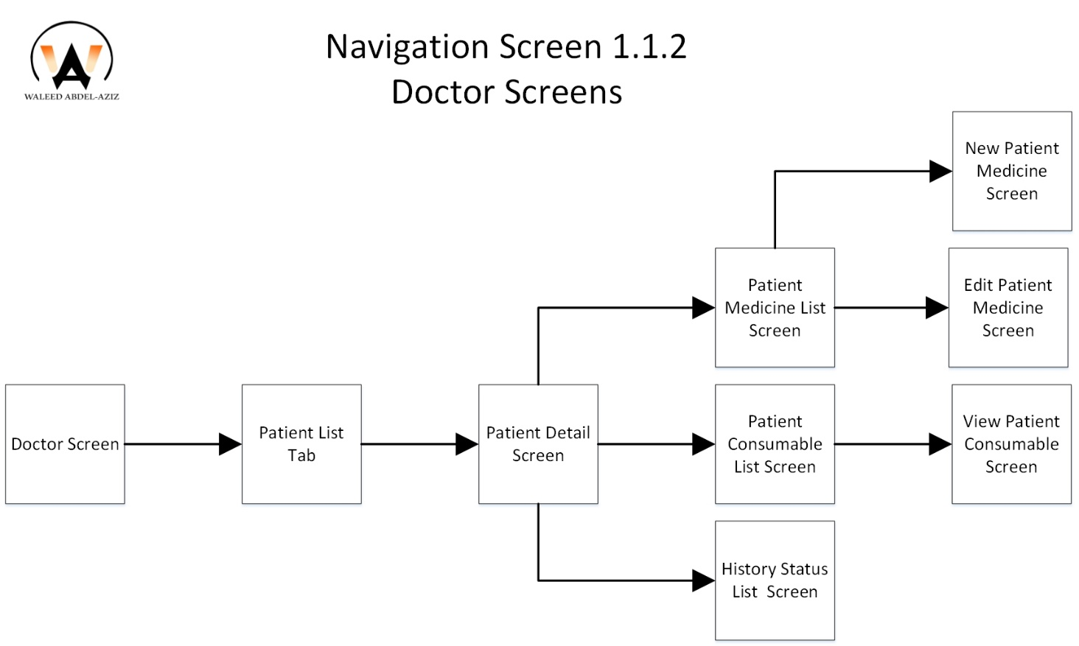
Doctor Navigation Screens (cont.)

Slide 26
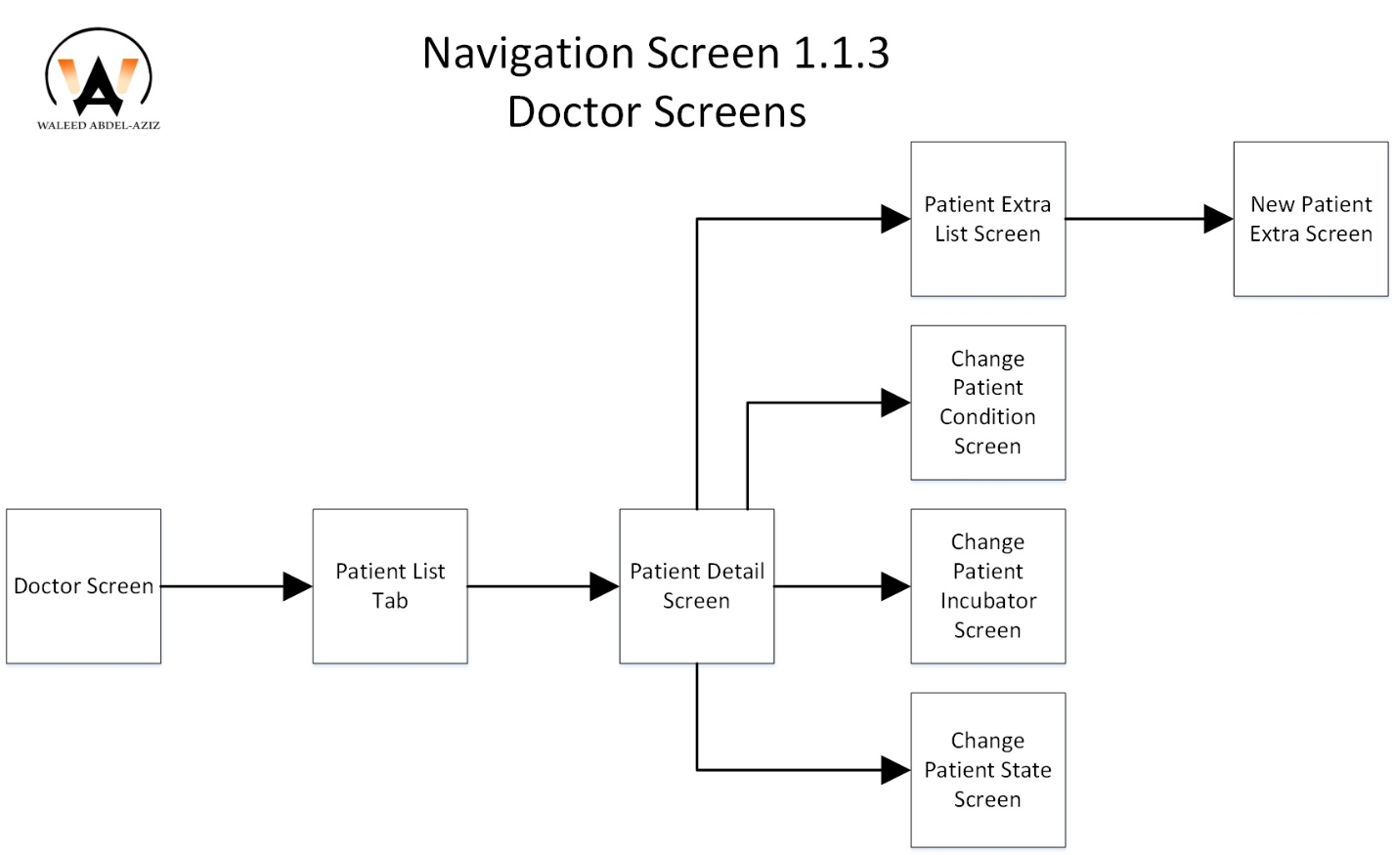
Doctor Navigation Screens (cont.)

Slide 27
Navigation Screen (Block Diagram)
Startup Navigation Screens
Doctor Navigation Screens
Nurse Navigation Screens
Accountant Navigation Screens
Patient Navigation Screens

Slide 28
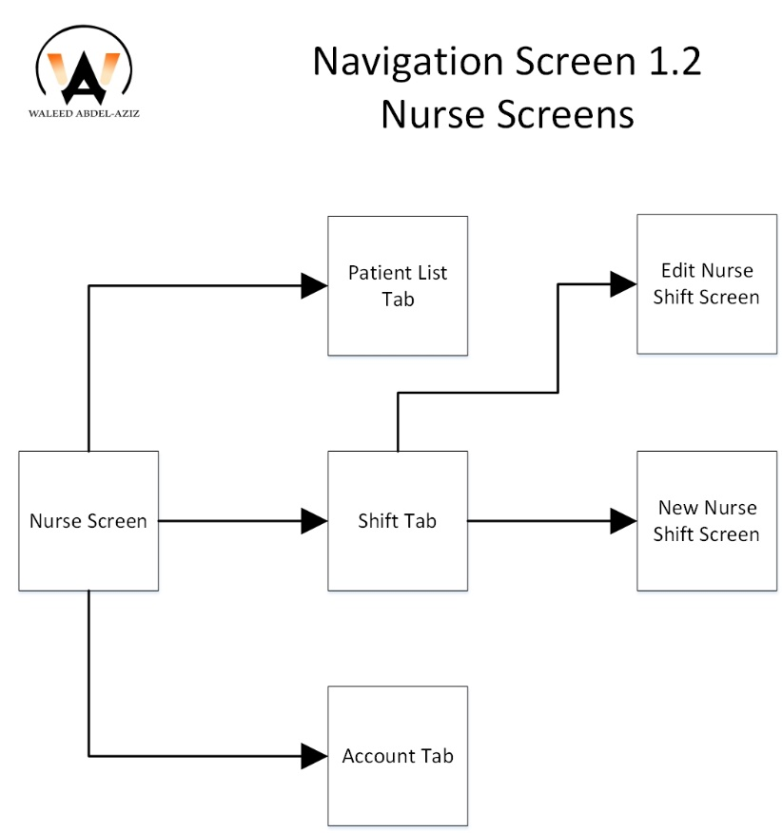
Nurse Navigation Screens

Slide 29
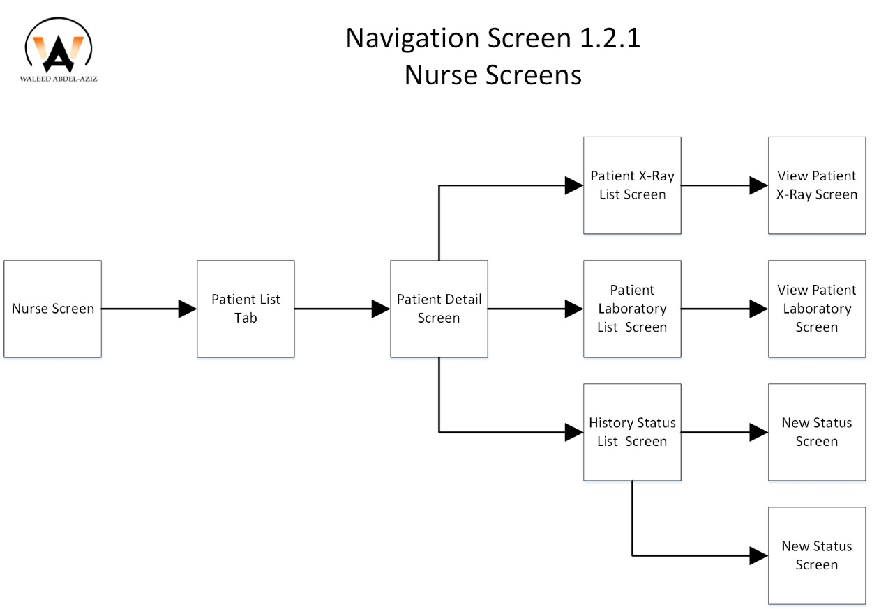
Nurse Navigation Screens (cont.)

Slide 30
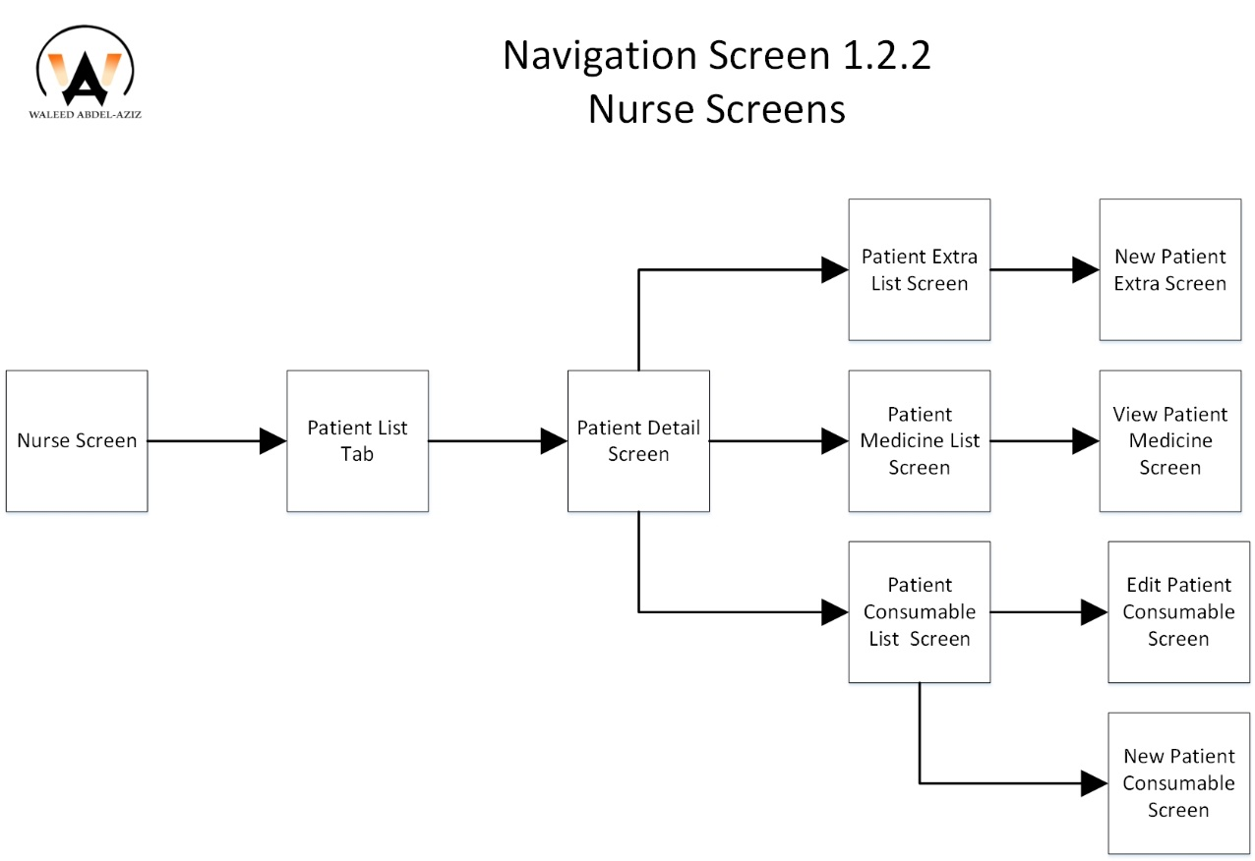
Nurse Navigation Screens (cont.)

Slide 31
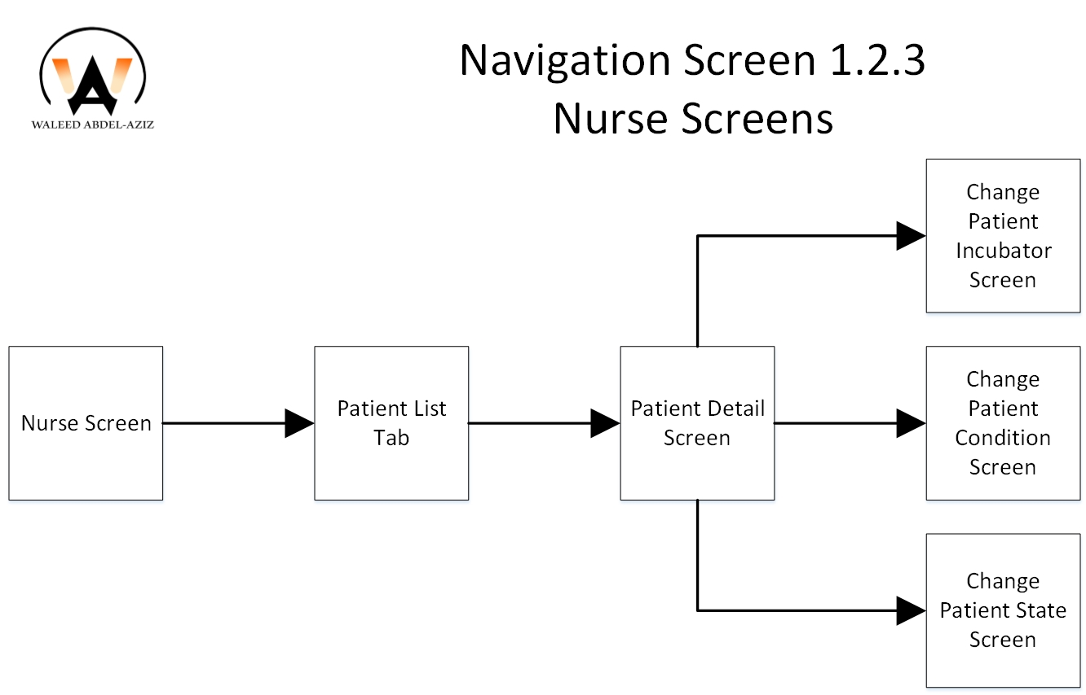
Nurse Navigation Screens (cont.)

Slide 32
Navigation Screen (Block Diagram)
Startup Navigation Screens
Doctor Navigation Screens
Nurse Navigation Screens
Accountant Navigation Screens
Patient Navigation Screens

Slide 33
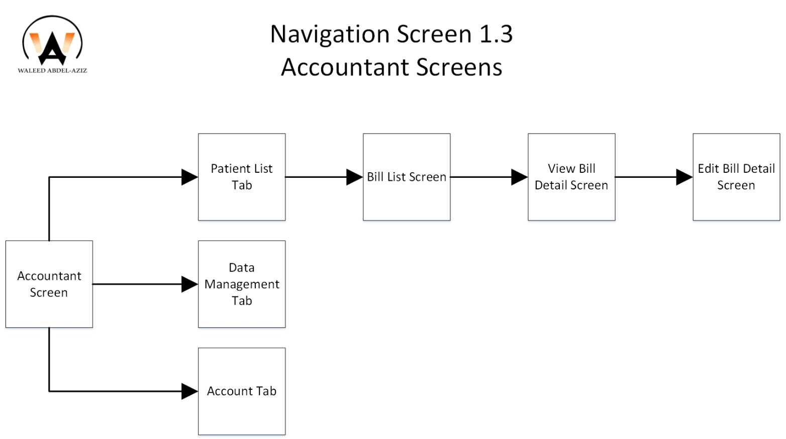
Accountant Navigation Screens

Slide 34
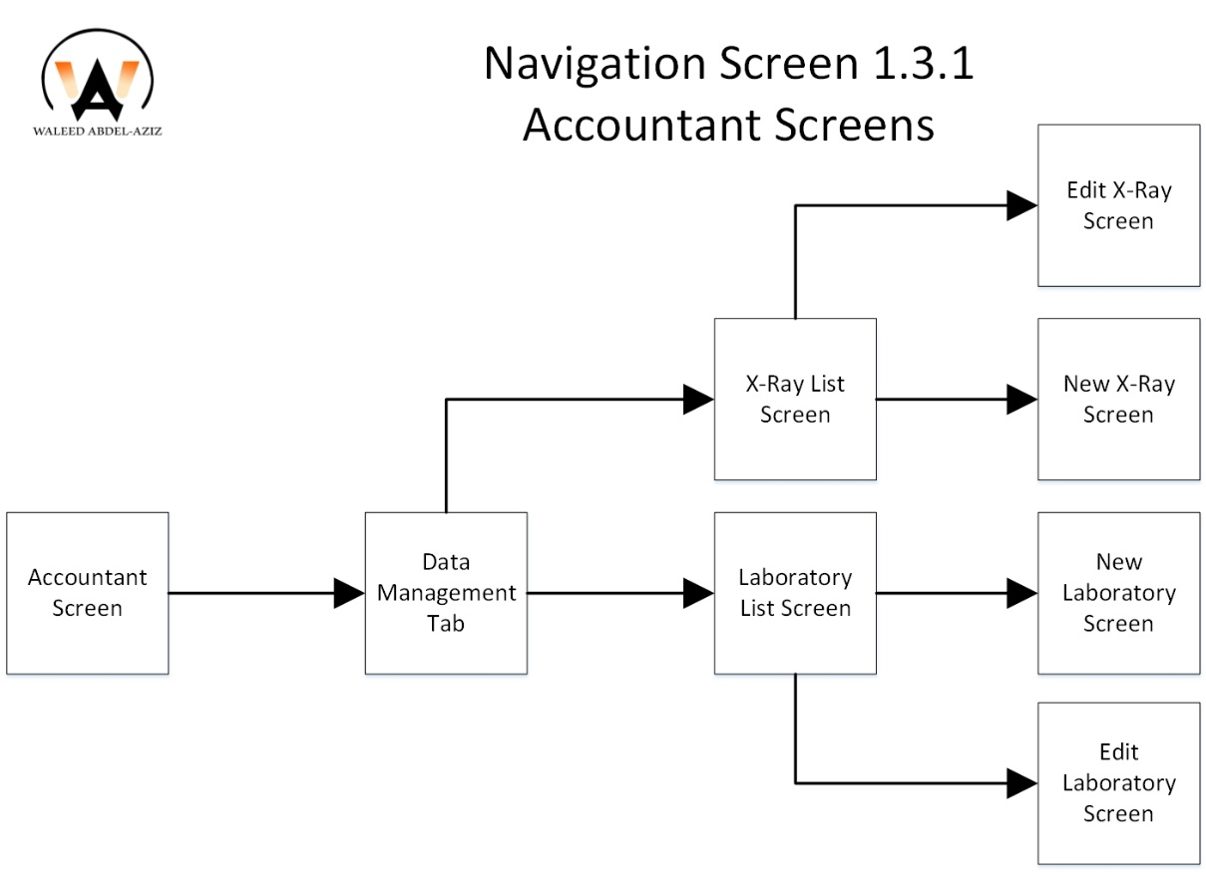
Accountant Navigation Screens (cont.)

Slide 35
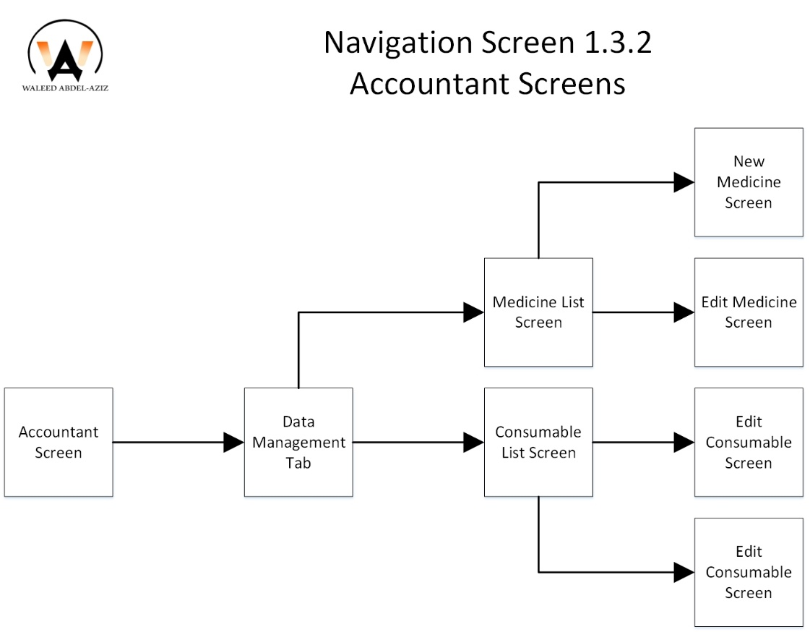
Accountant Navigation Screens (cont.)

Slide 36
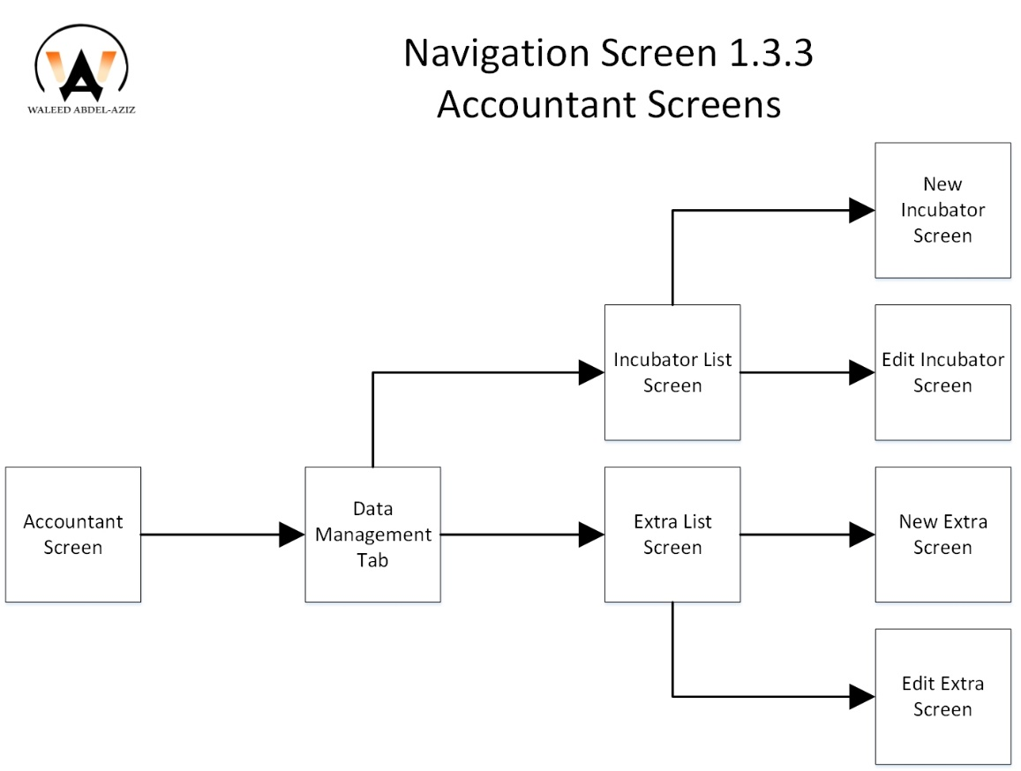
Accountant Navigation Screens (cont.)

Slide 37
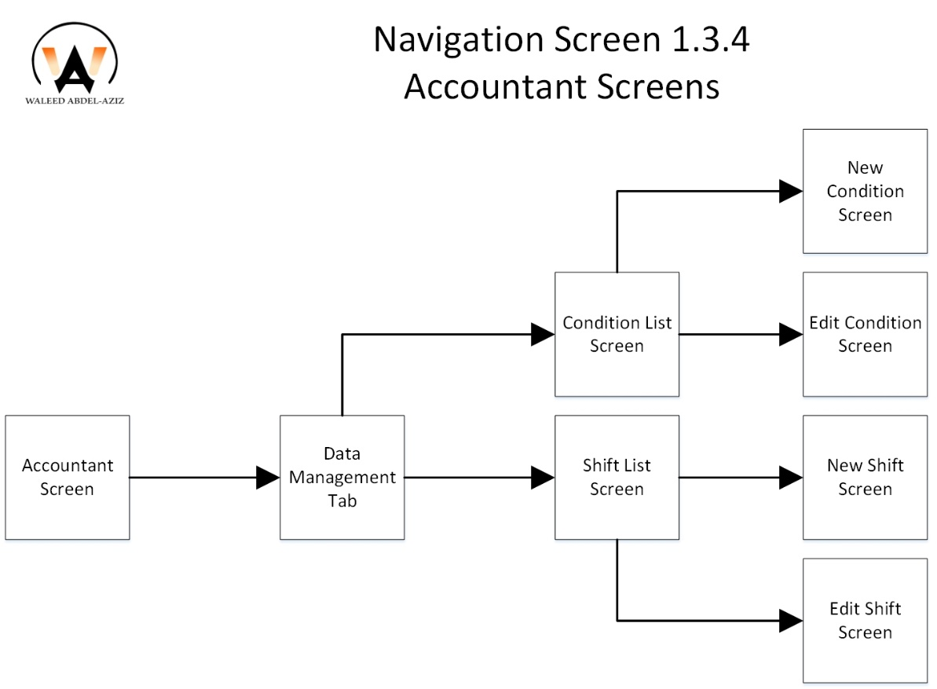
Accountant Navigation Screens (cont.)

Slide 38
Navigation Screen (Block Diagram)
Startup Navigation Screens
Doctor Navigation Screens
Nurse Navigation Screens
Accountant Navigation Screens
Patient Navigation Screens

Slide 39
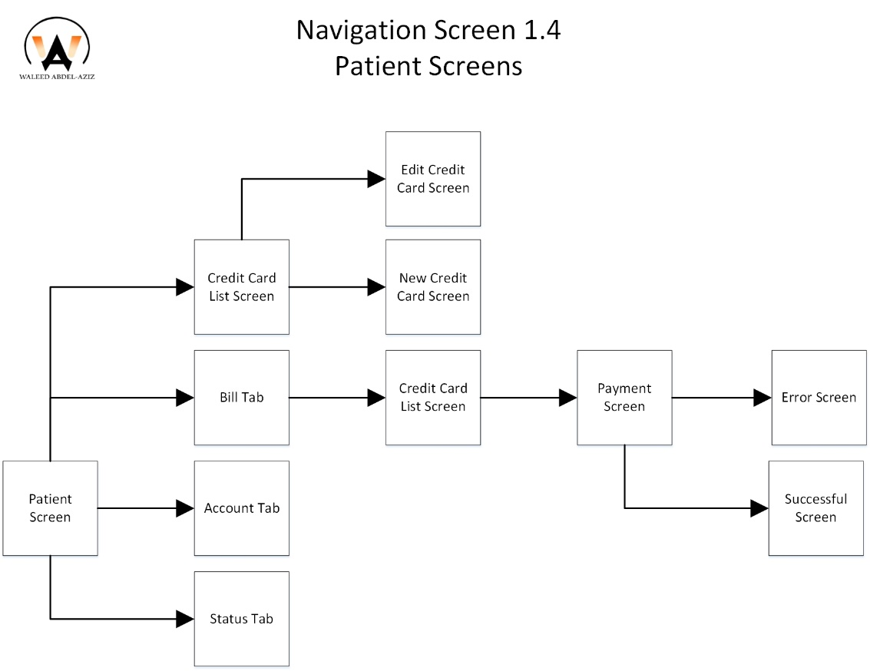
Patient Navigation Screens

Slide 40
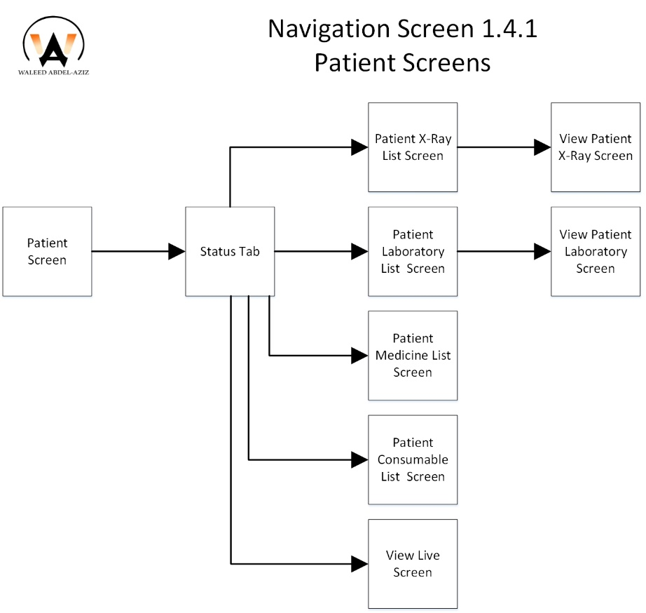
Patient Navigation Screens (cont.)

Slide 41
Agenda
Introduction
Problem Definition
Proposed Solution
Main Goal(s)
Features
Ark Work
Navigation Screen (Block Diagram)
Screen Shot (GUI)
Hardware Specification (Mobile device)
Tools
Demo
Future Work

Slide 42
Screen Shoot
Startup Screen
Register Screens
Patient Screens
Doctor Screens
Nurse Screens
Accountant Screens

Slide 43
Screen Shoot
Startup Screen
Register Screens
Patient Screens
Doctor Screens
Nurse Screens
Accountant Screens

Slide 44
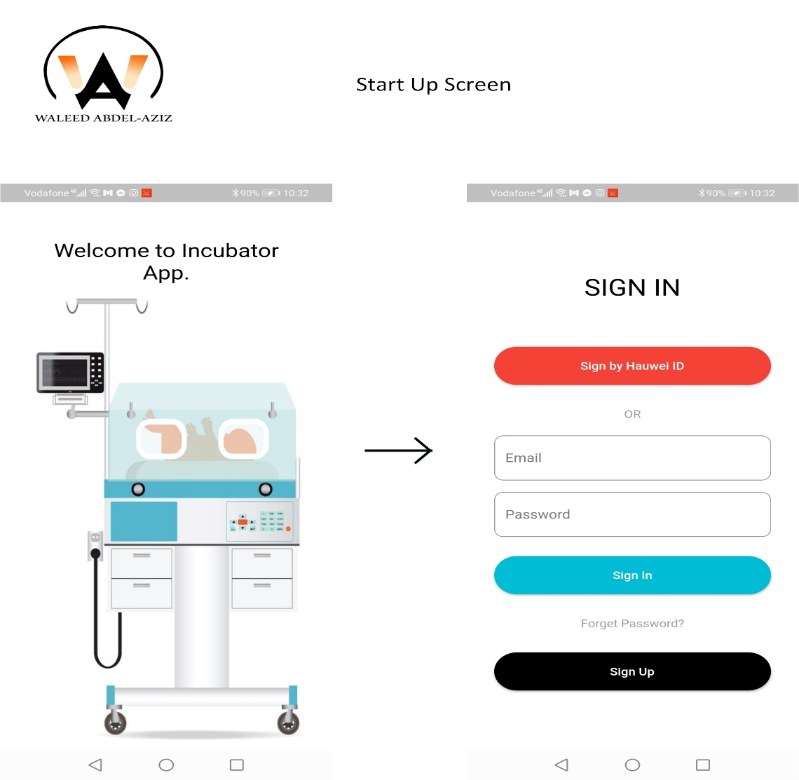
Startup Screen
The app starts and shows welcome screen and navigates to Sign In Screen

Slide 45
Screen Shoot
Startup Screen
Register Screens
Patient Screens
Doctor Screens
Nurse Screens
Accountant Screens

Slide 46
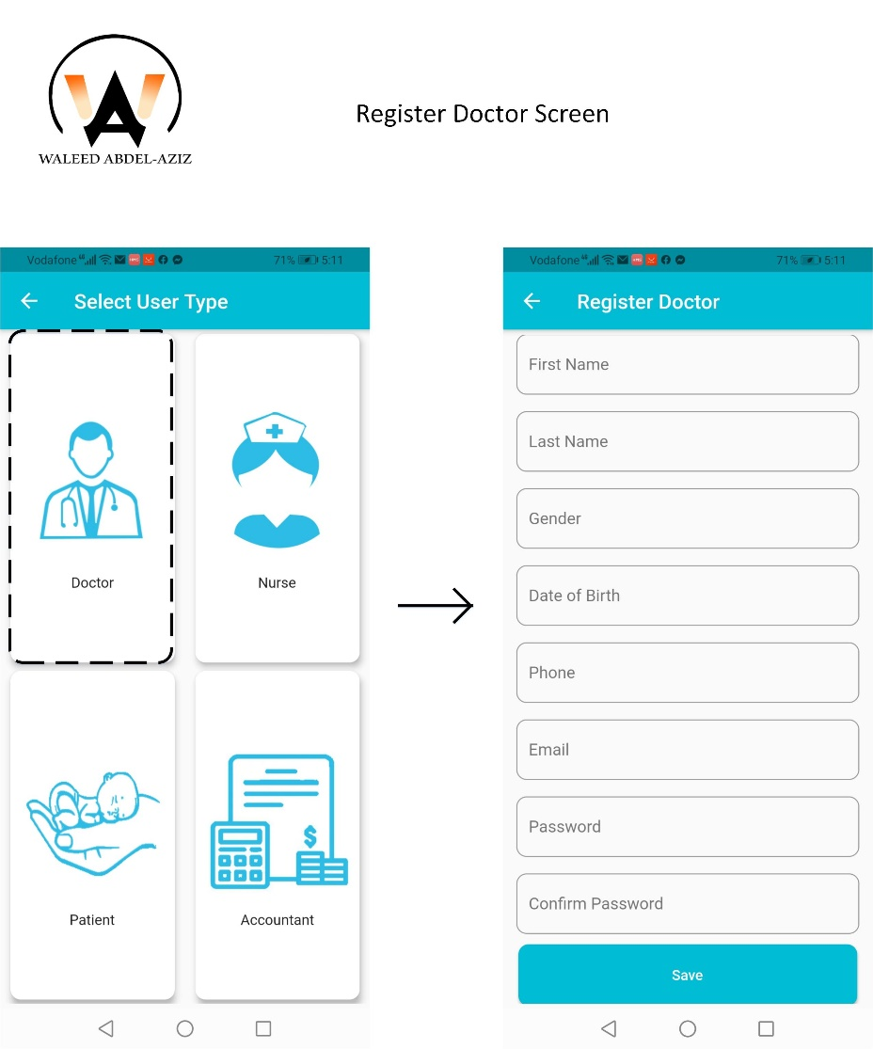
Register Screen(s) (cont.)
Click on Doctor Button Navigates to Register Doctor Screen

Slide 47
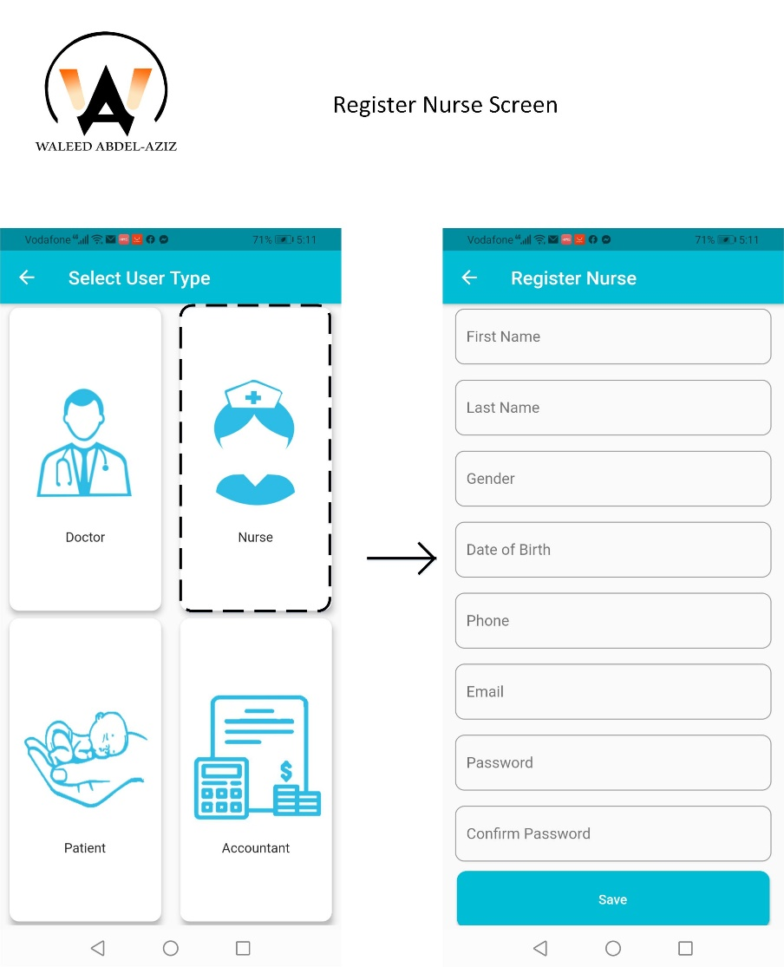
Register Screen(s) (cont.)
Click on Nurse Button Navigates to Register Nurse Screen

Slide 48
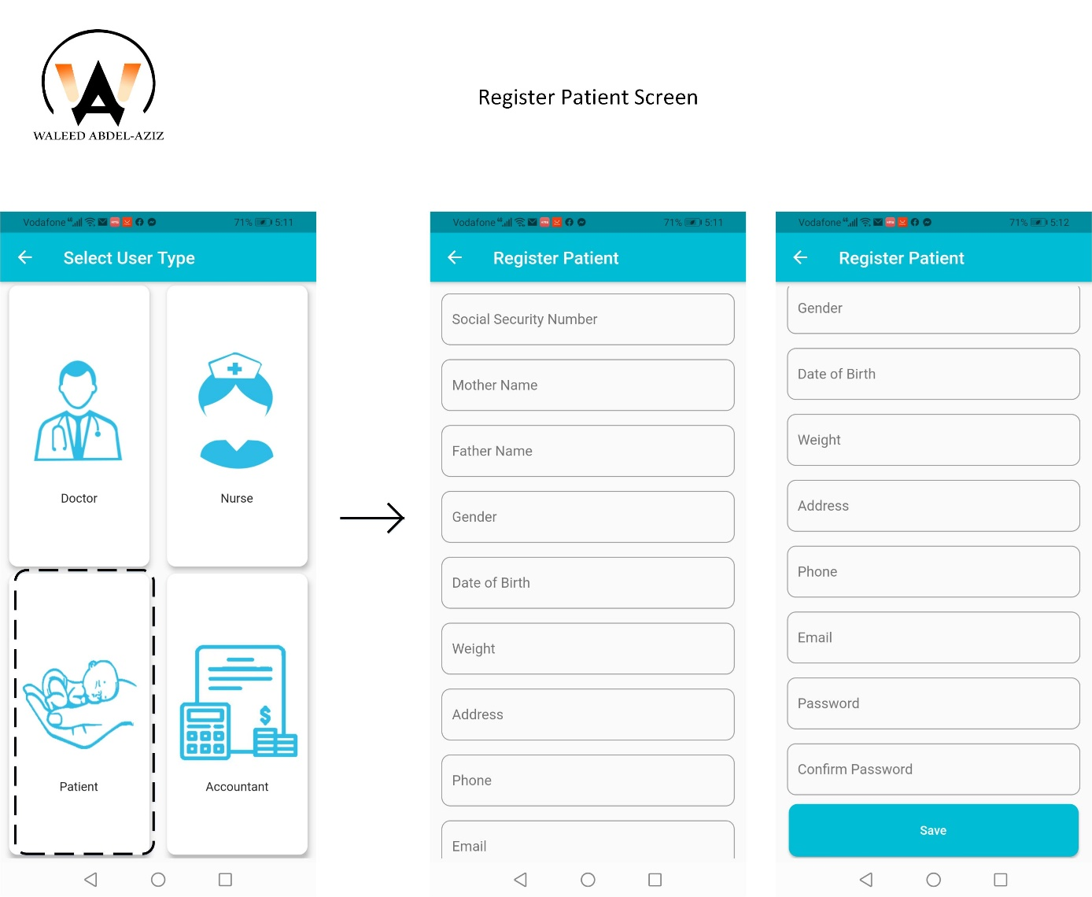
Register Screen(s) (cont.)
Click on Patient Button Navigates to Register Patient Screen

Slide 49
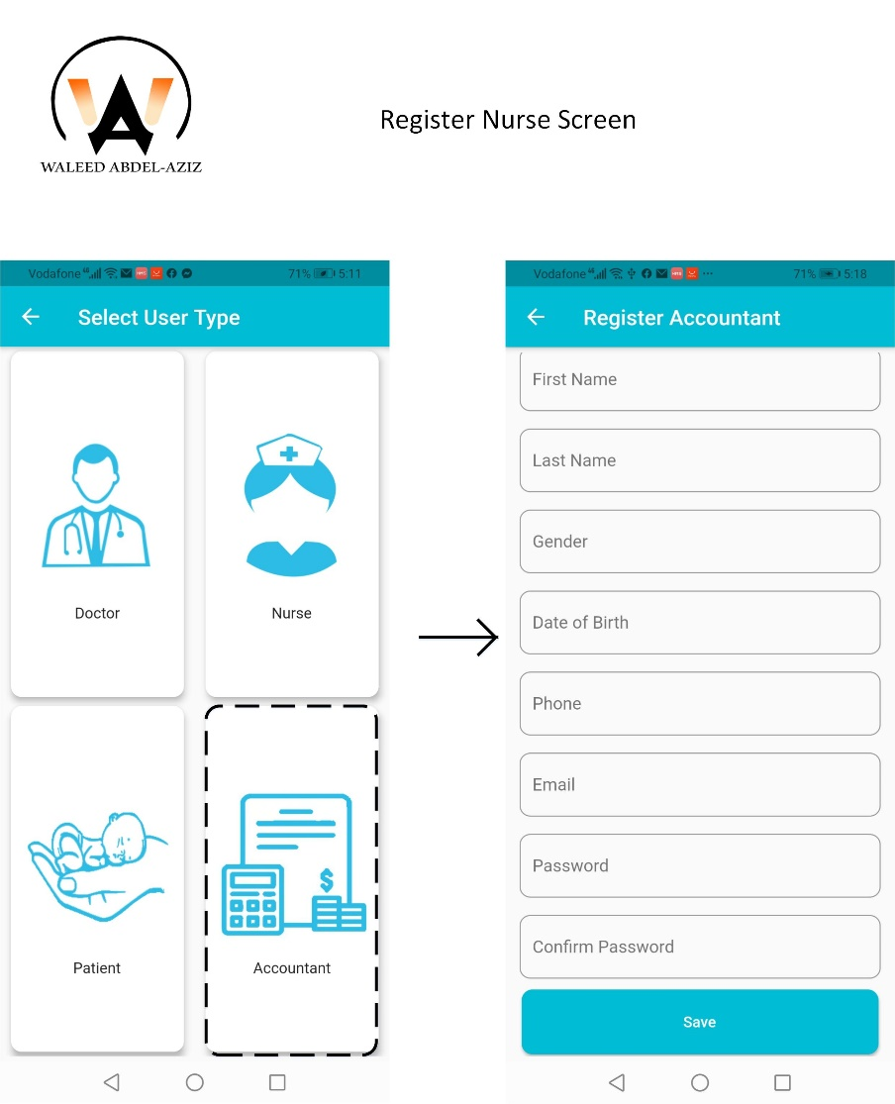
Register Screen(s) (cont.)
Click on Accountant Button Navigates to Register Accountant Screen

Slide 50
Screen Shoot
Startup Screen
Register Screens
Patient Screens
Doctor Screens
Nurse Screens
Accountant Screens

Slide 51
Patient Screens

Slide 52
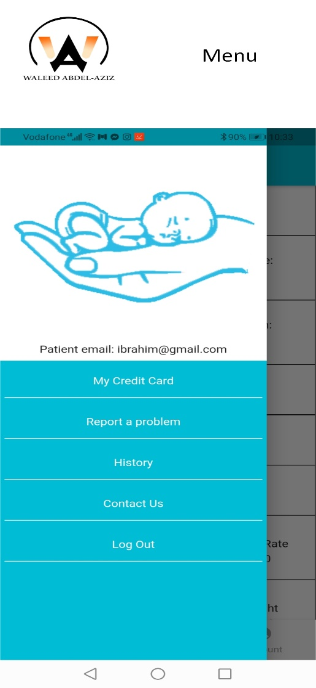
Patient Screens (cont.)
Slide Menu from Left to right, shows options for current Patient (User)

Slide 53
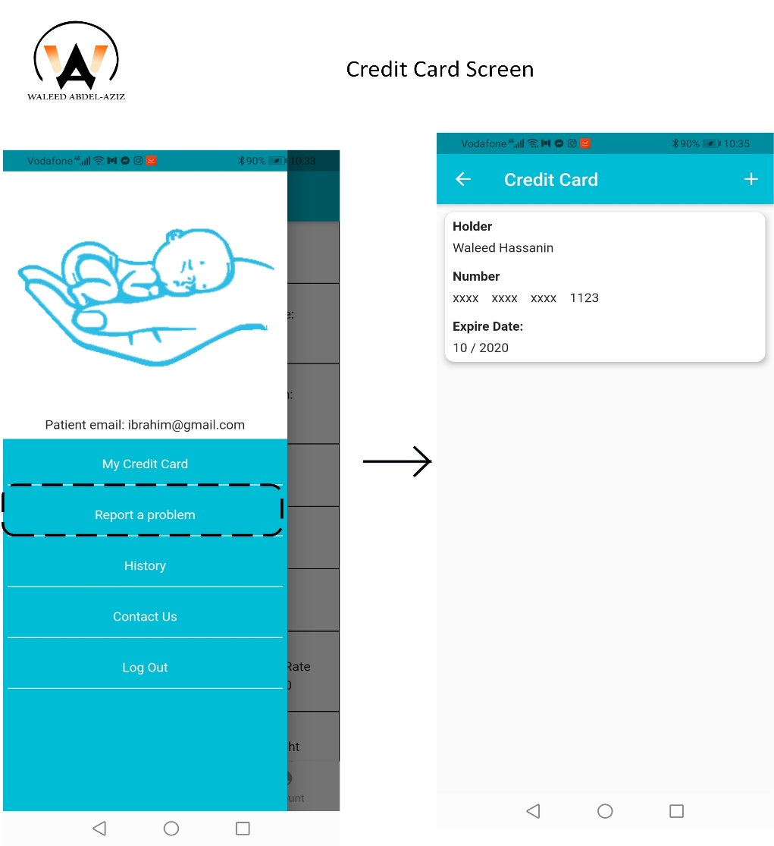
Patient Screens (cont.)

Slide 54
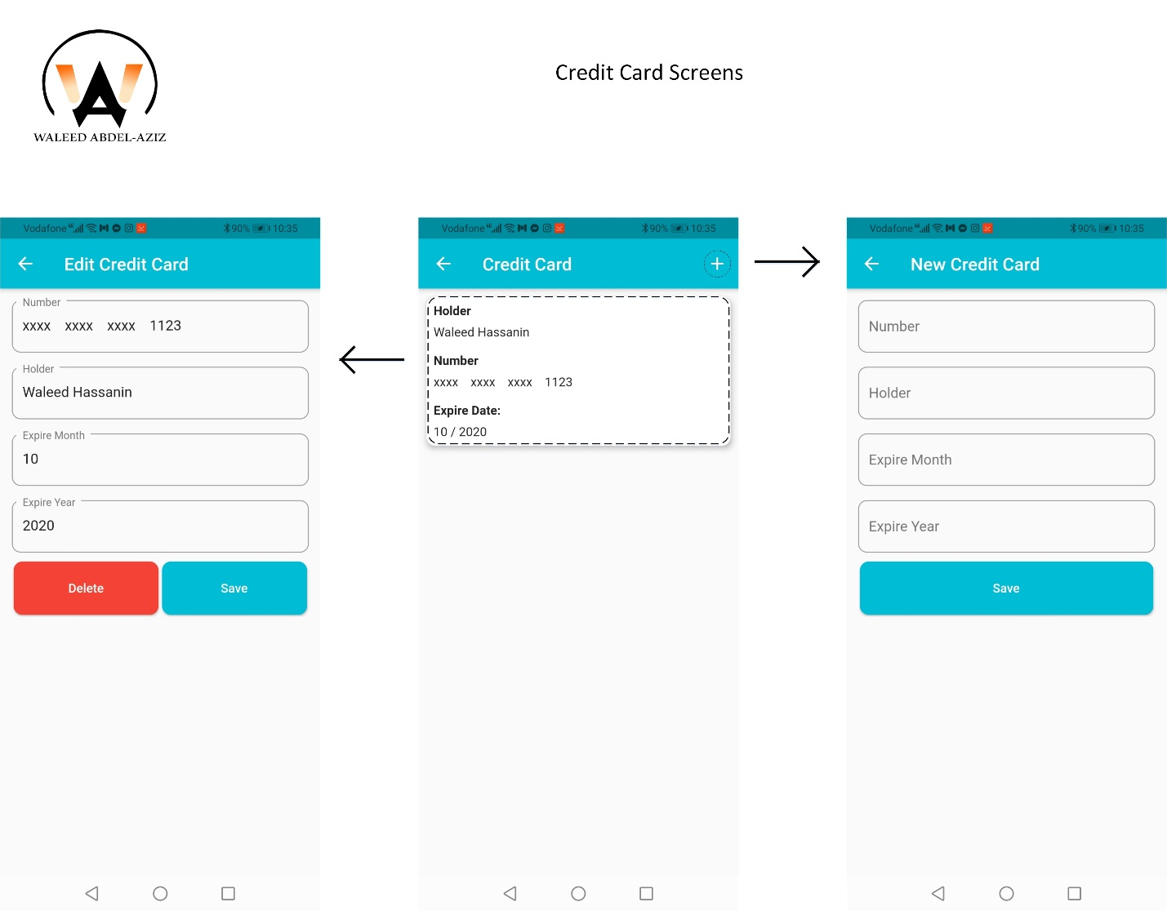
Patient Screens (cont.)
Click on add button Navigates to new Credit Card Screen
Tap on one of Credit Card List navigates to Edit Credit Card Screen

Slide 55
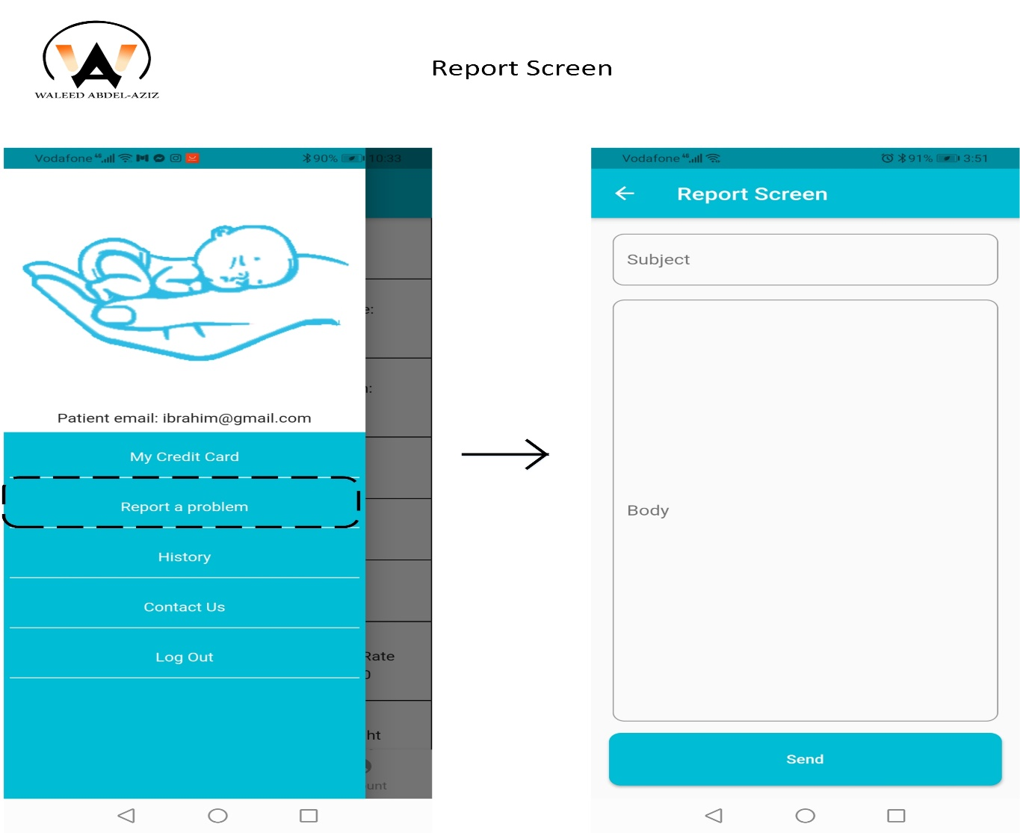
Patient Screens (cont.)
Click on Report a problem button navigates to Report Screen

Slide 56
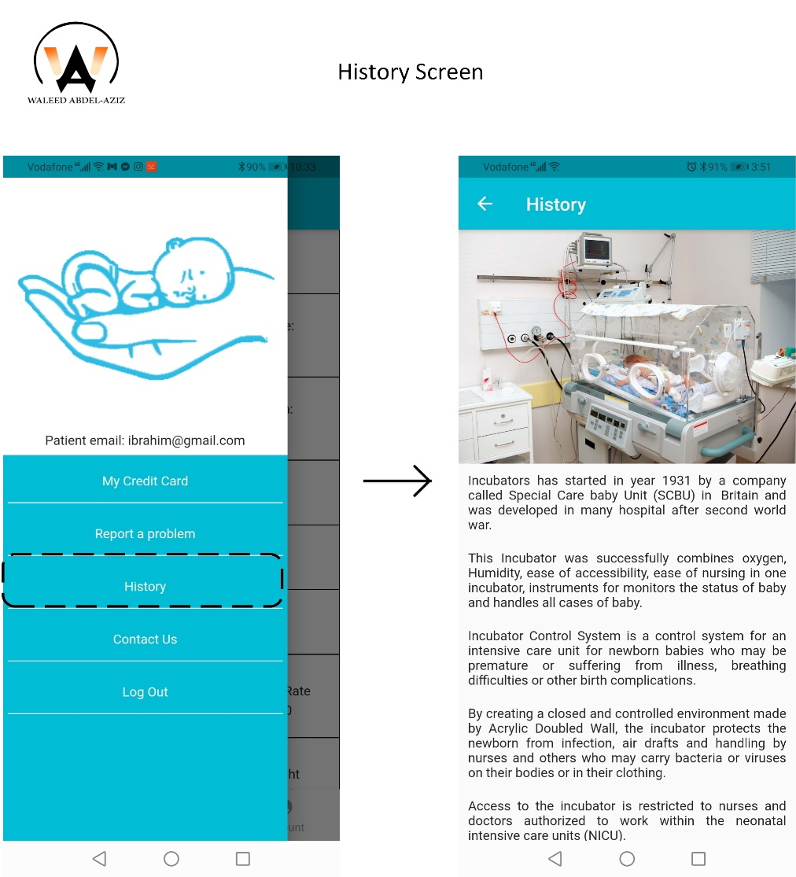
Patient Screens (cont.)
Click on History button navigates to History Screen

Slide 57
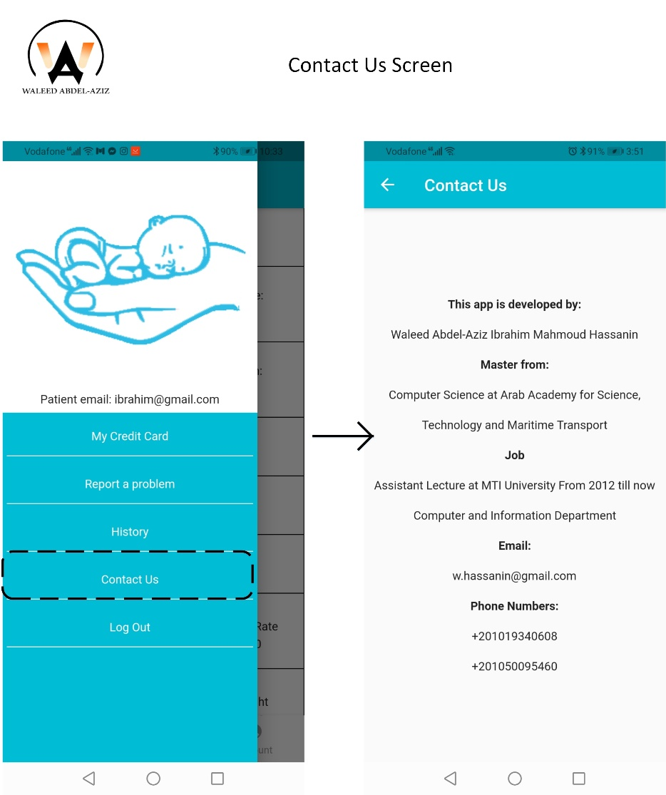
Patient Screens (cont.)
Click on History button navigates to History Screen

Slide 58
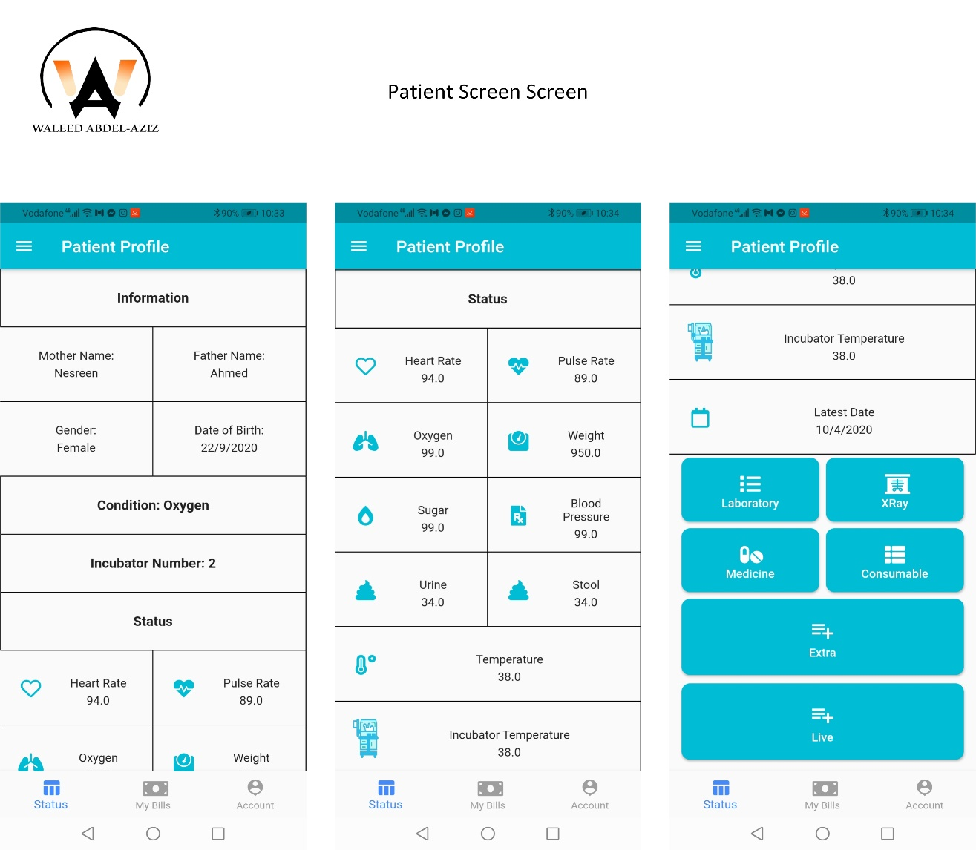
Patient Screens (cont.)
This is the home screen of newborn medical records shows data consists of:
Information of newborn
Condition
Incubator Number
Status
Buttons for each to display more details:
Laboratory
X-Ray
Extra
Medicine
Consumable
Live

Slide 59
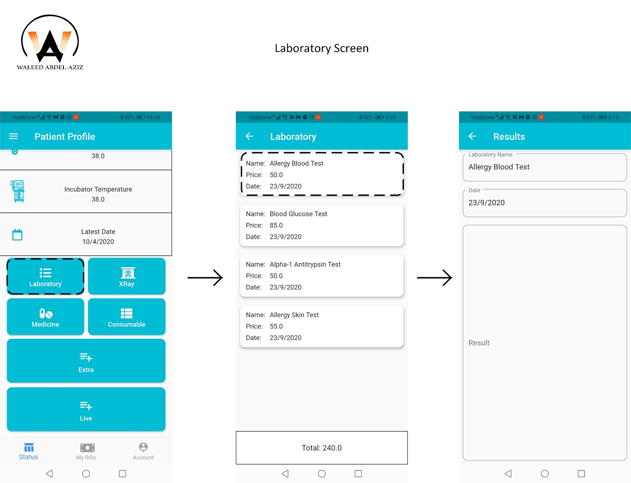
Patient Screens (cont.)
Click on Laboratory button navigates to Laboratory Screen
Tap on one of Laboratory List navigates to Result Screen

Slide 60
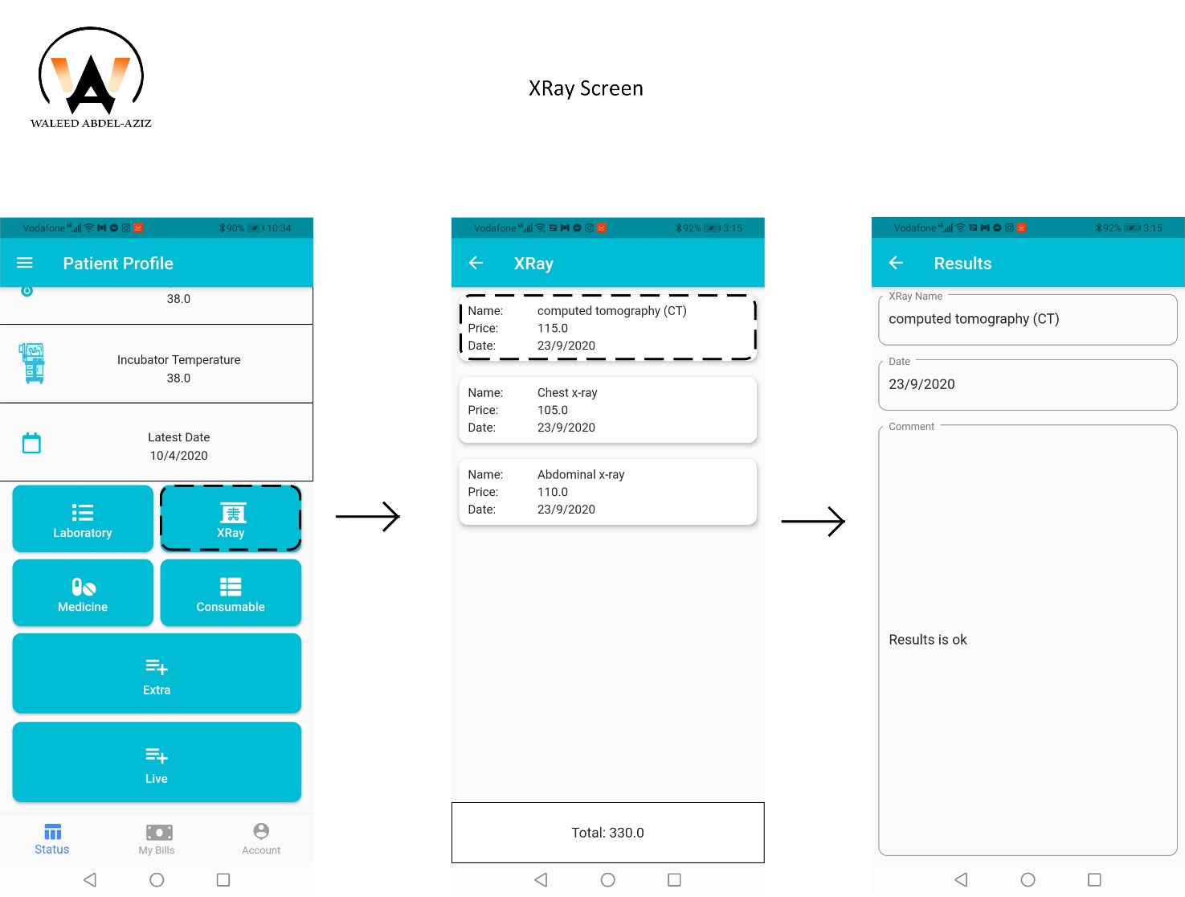
Patient Screens (cont.)
Click on X-Ray button navigates to X-Ray Screen
Tap on one of X-Ray List navigates to Result Screen

Slide 61
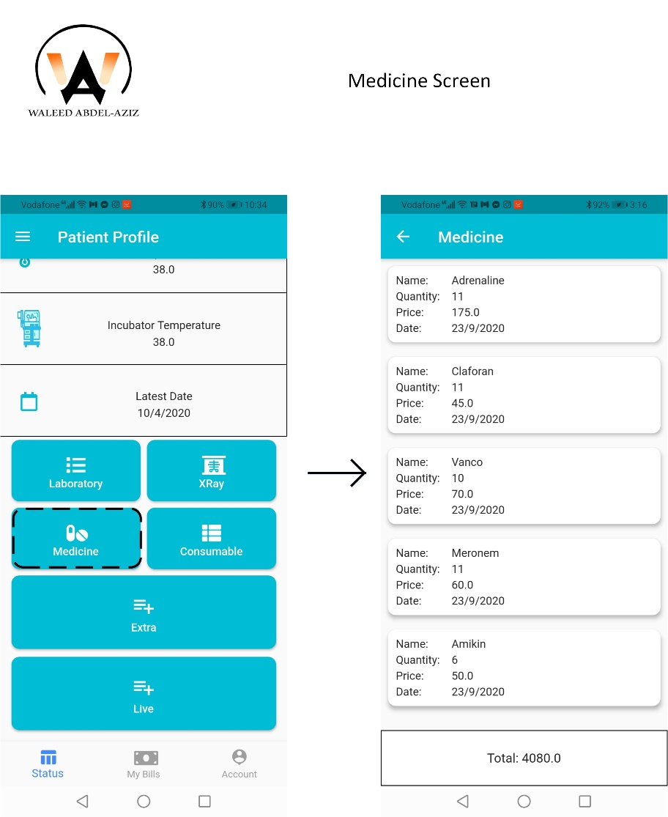
Patient Screens (cont.)
Click on Medicine button navigates to Medicine Screen

Slide 62
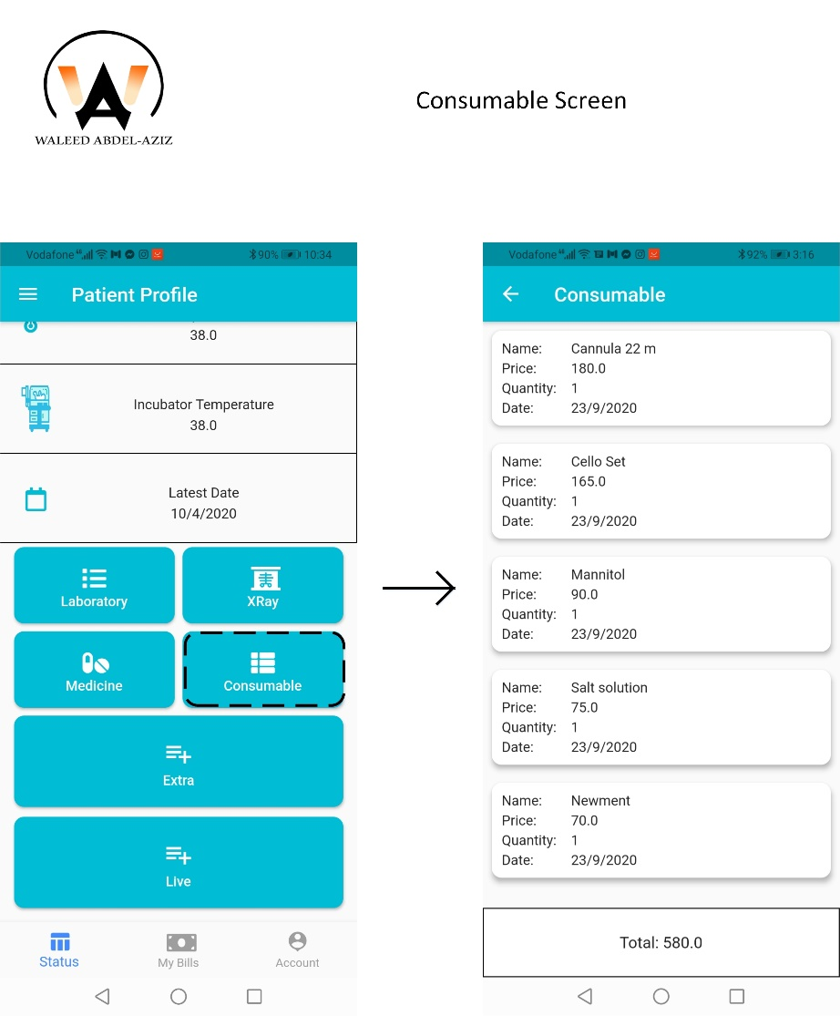
Patient Screens (cont.)
Click on Consumable button navigates to Consumable Screen

Slide 63
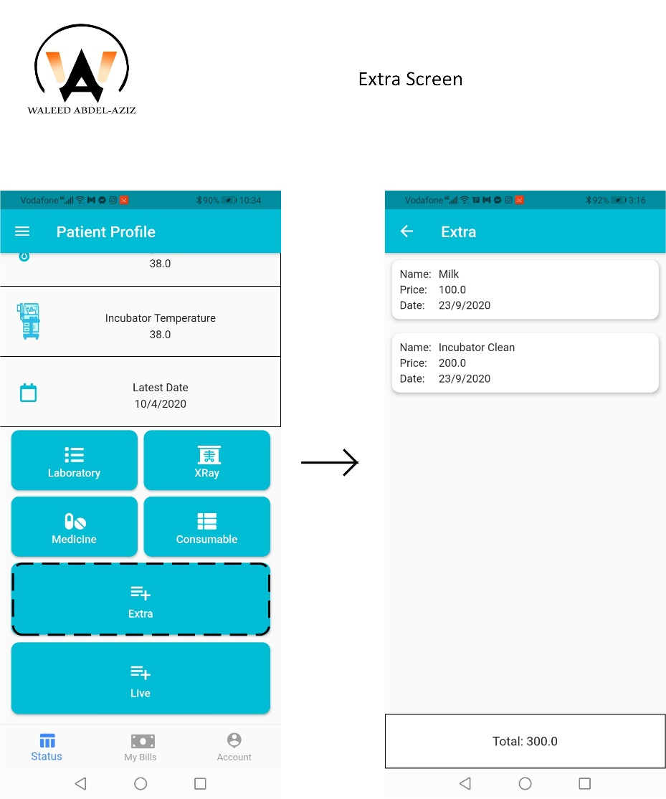
Patient Screens (cont.)
Click on Extra button navigates to Extra Screen

Slide 64
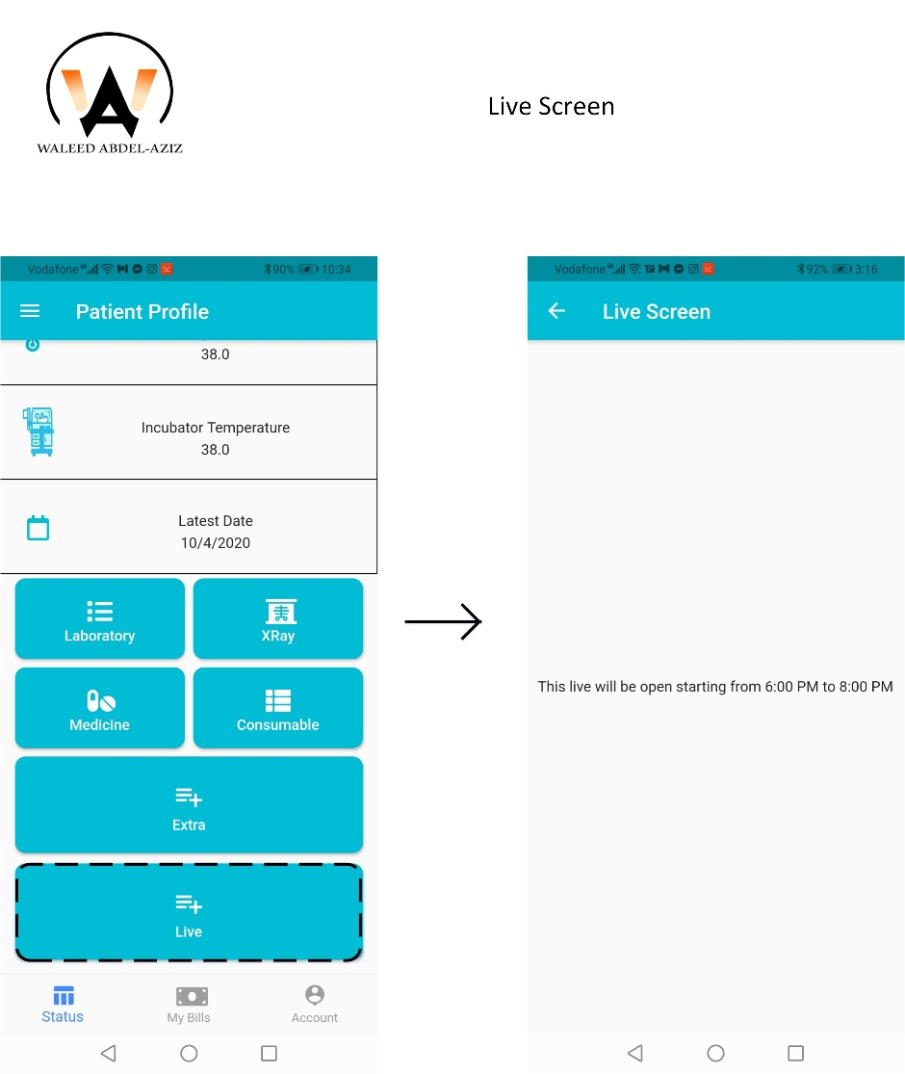
Patient Screens (cont.)
Click on Live button navigates to Live Screen

Slide 65
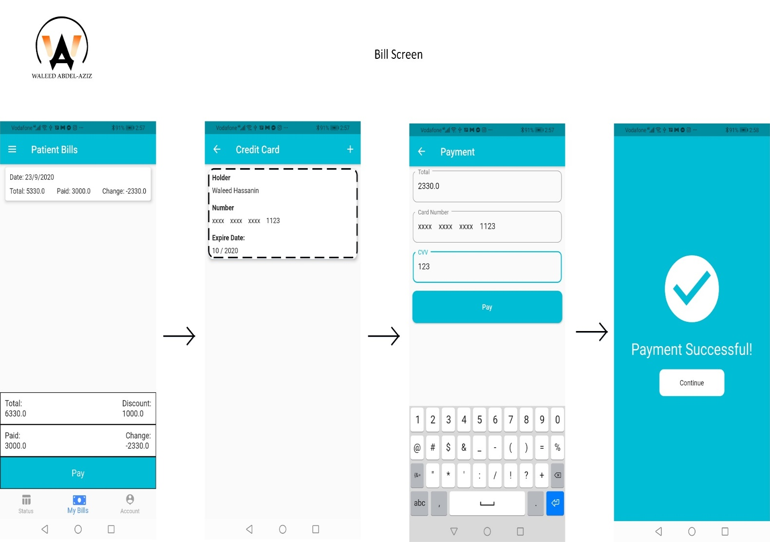
Patient Screens (cont.)
From Patient Bills Screen on pay button navigates to Credit Card List Screen
Tap on one of Credit Card List Screen Navigates to Payment Screen
From Payment Screen click on pay button navigates to Payment Successful Screen

Slide 66
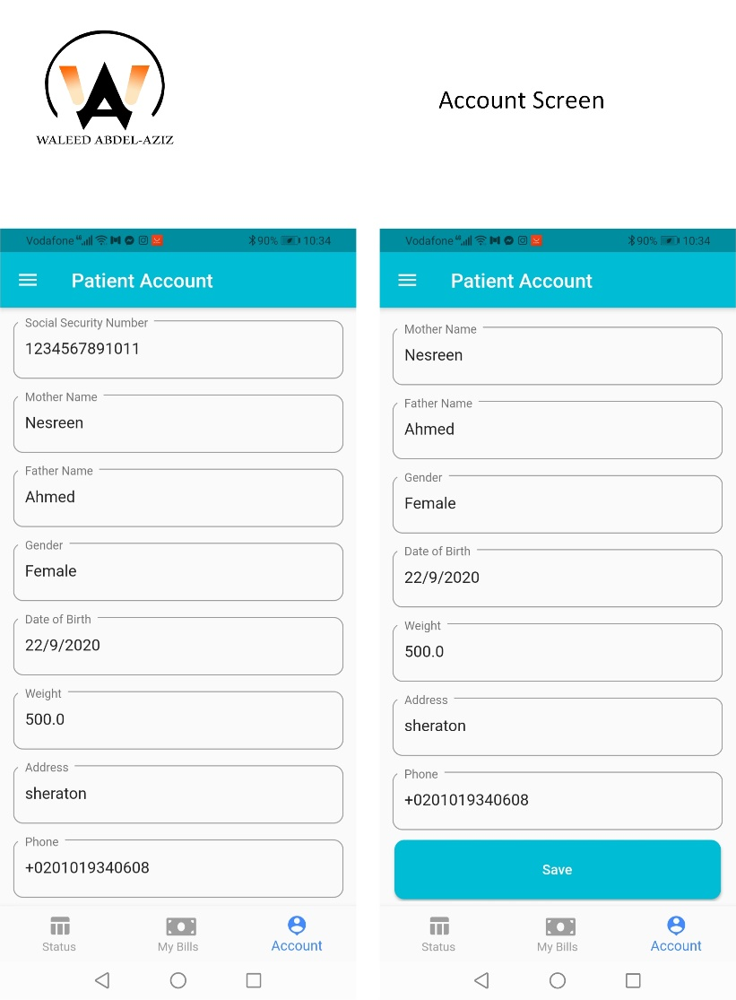
Patient Screens (cont.)
This is Patient Account Screen for update information

Slide 67
Screen Shoot
Startup Screen
Register Screens
Patient Screens
Doctor Screens
Nurse Screens
Accountant Screens

Slide 68
Doctor Screens

Slide 69
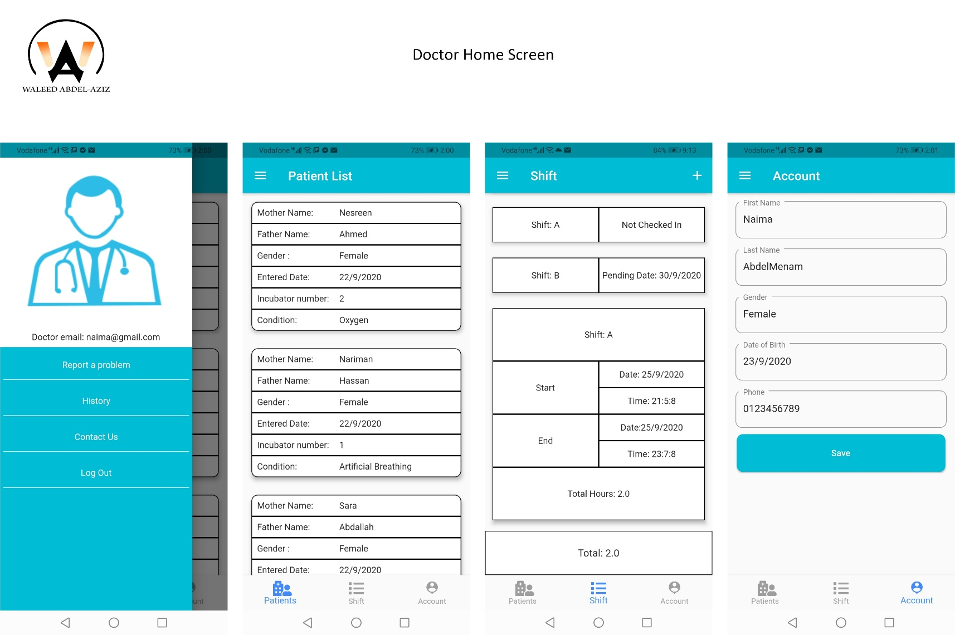
Doctor Screens (cont.)
This is Home Screen for User ( Doctor)

Slide 70
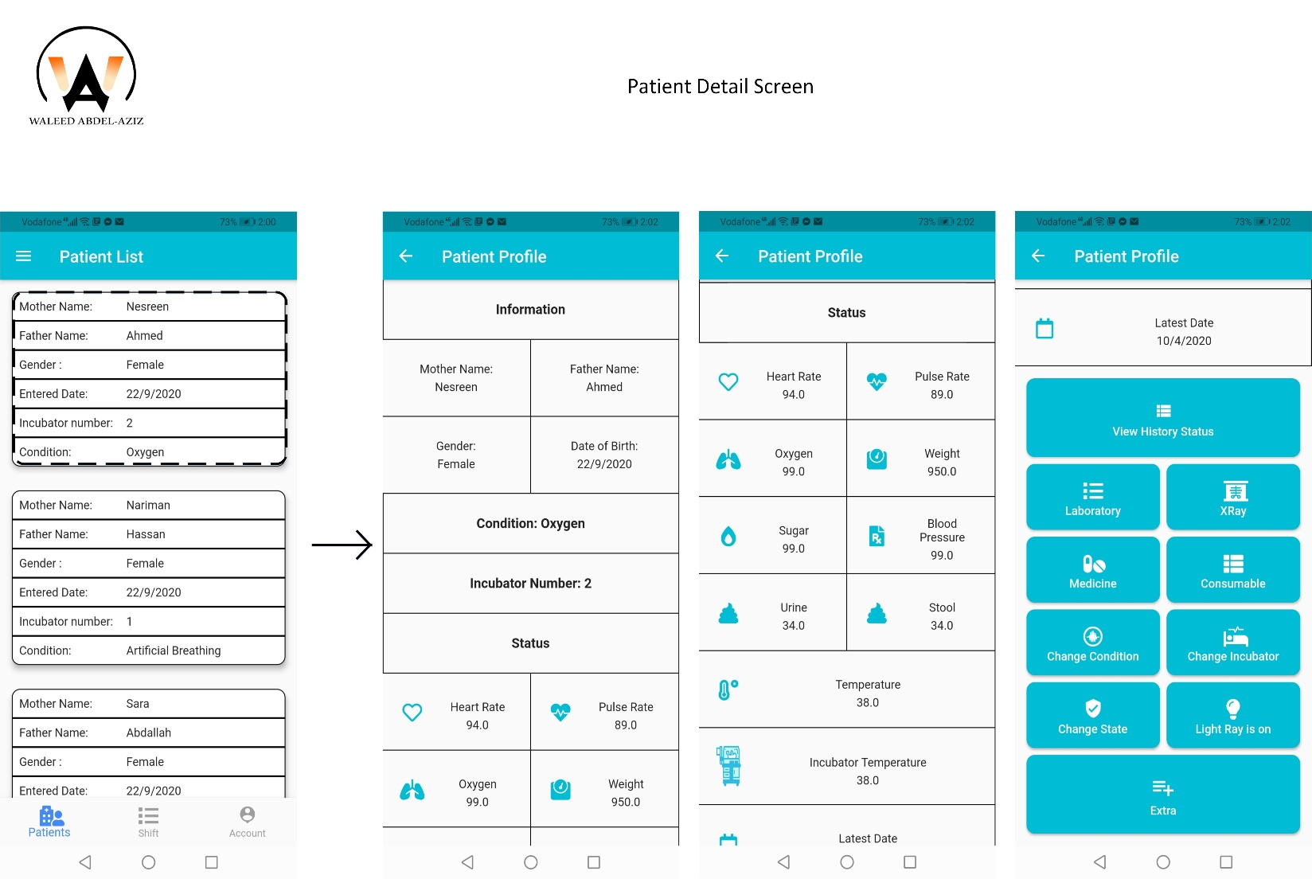
Doctor Screens (cont.)
Tap on one of patient list navigates to Patient Profile Screen

Slide 71
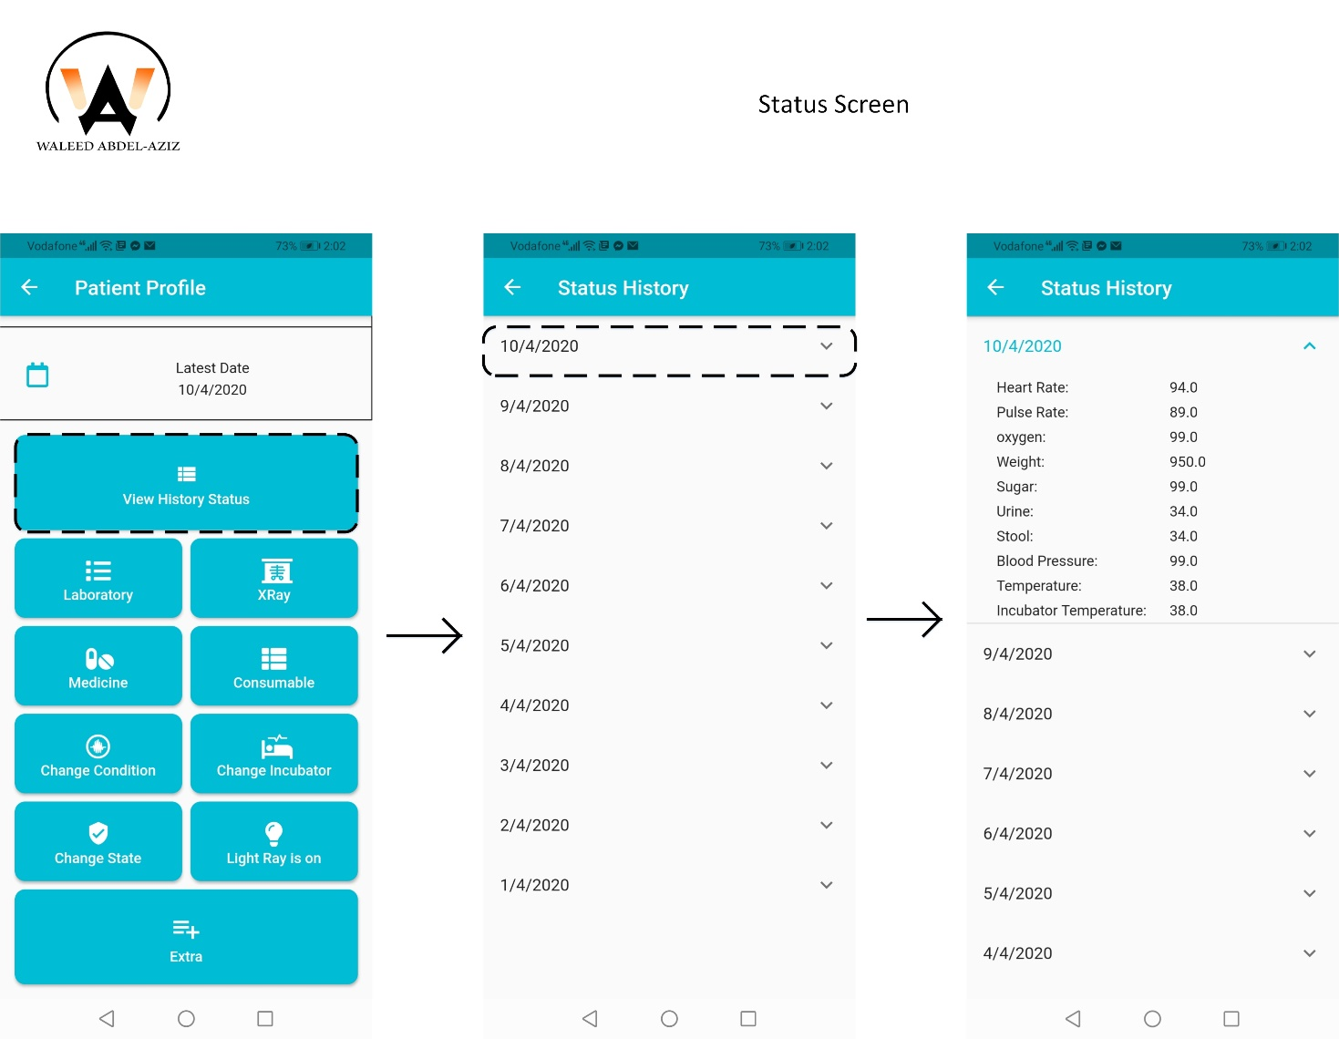
Doctor Screens (cont.)
Click on View History Status Button navigates to Status History Screen
Tap on one of dates, It expands the details of status

Slide 72
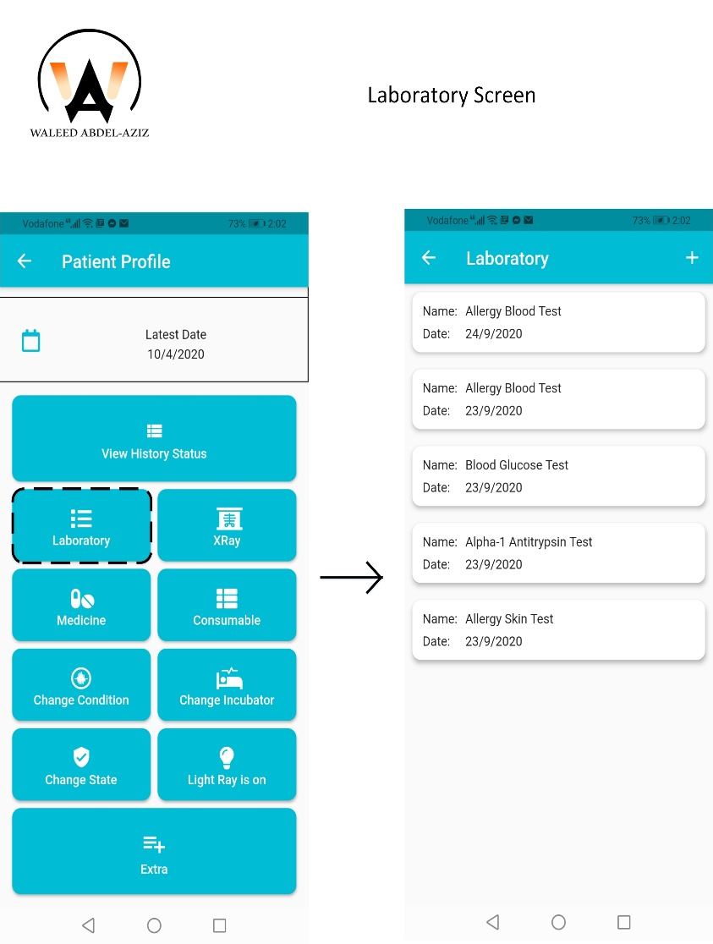
Doctor Screens (cont.)

Slide 73
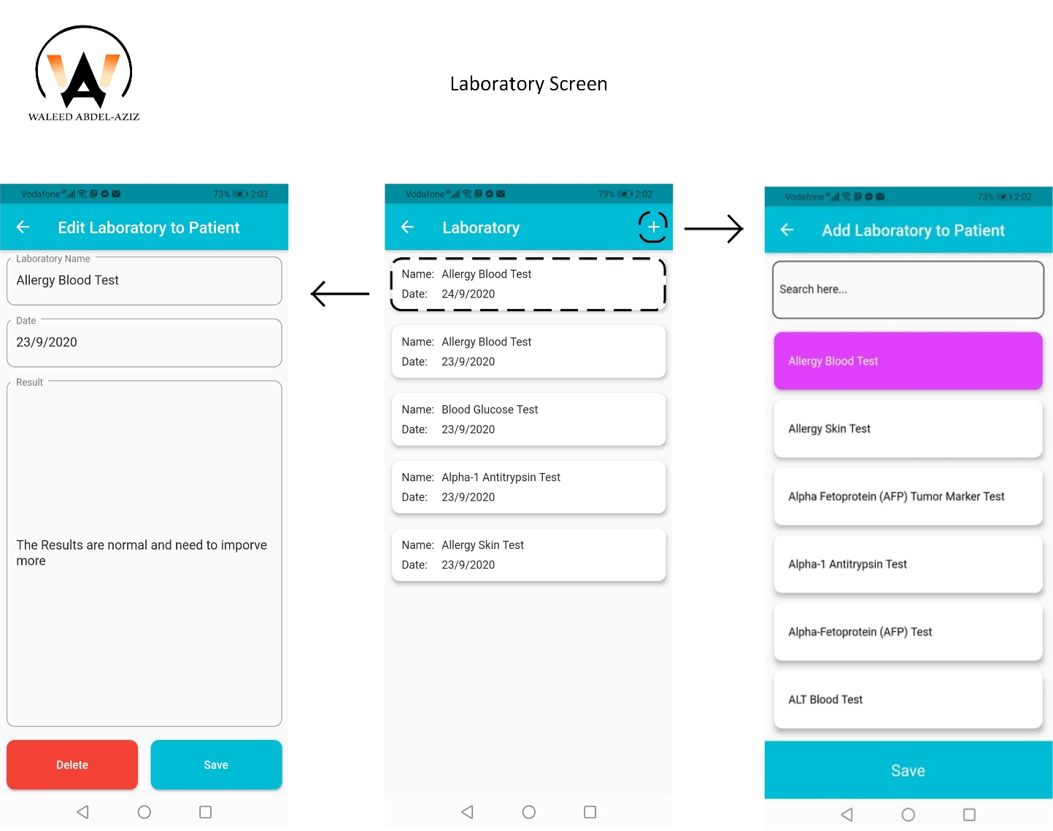
Doctor Screens (cont.)

Slide 74
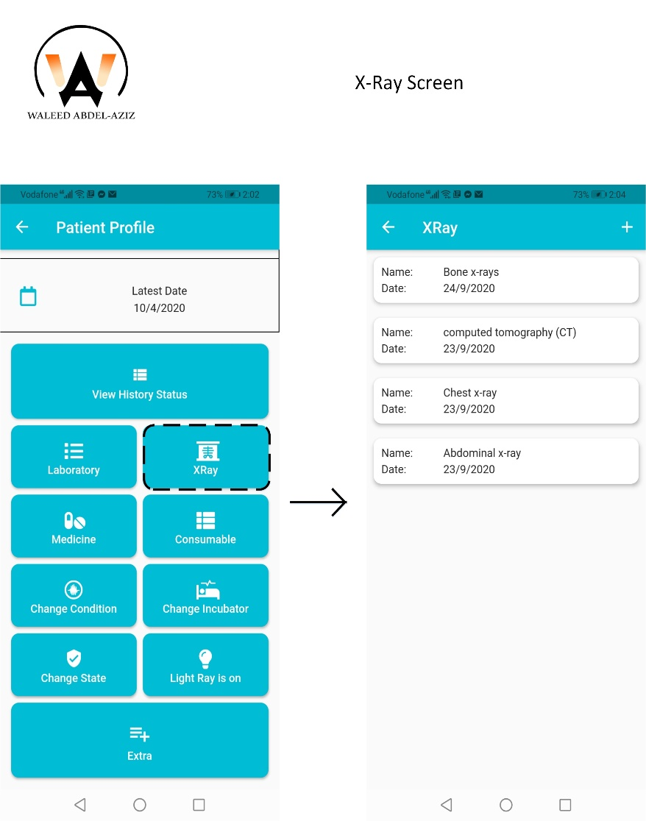
Doctor Screens (cont.)

Slide 75
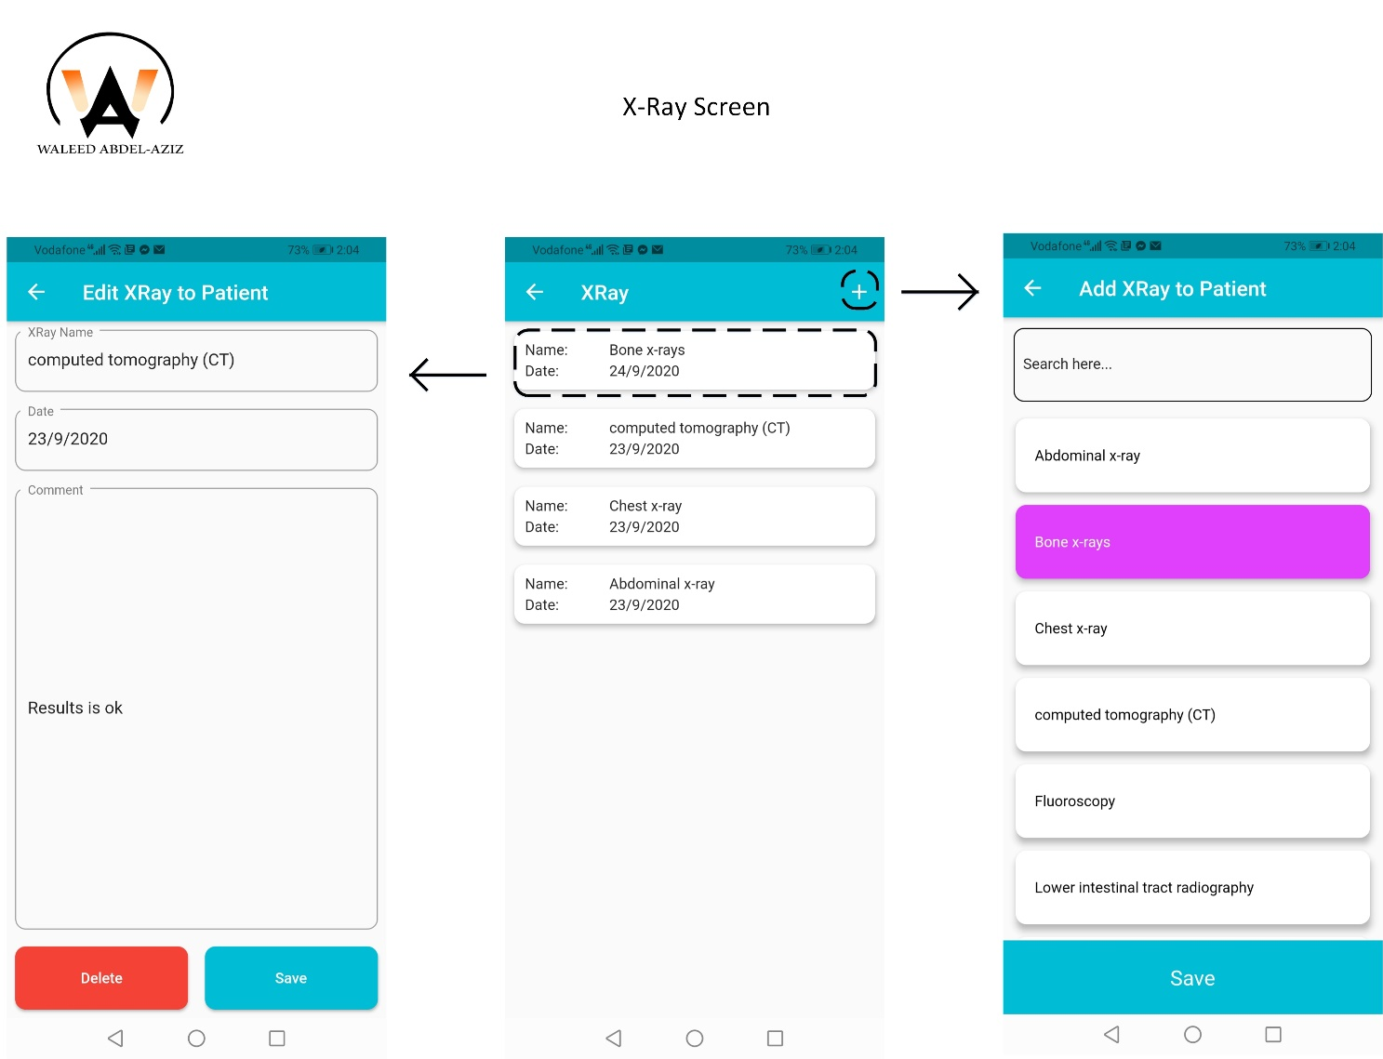
Doctor Screens (cont.)

Slide 76
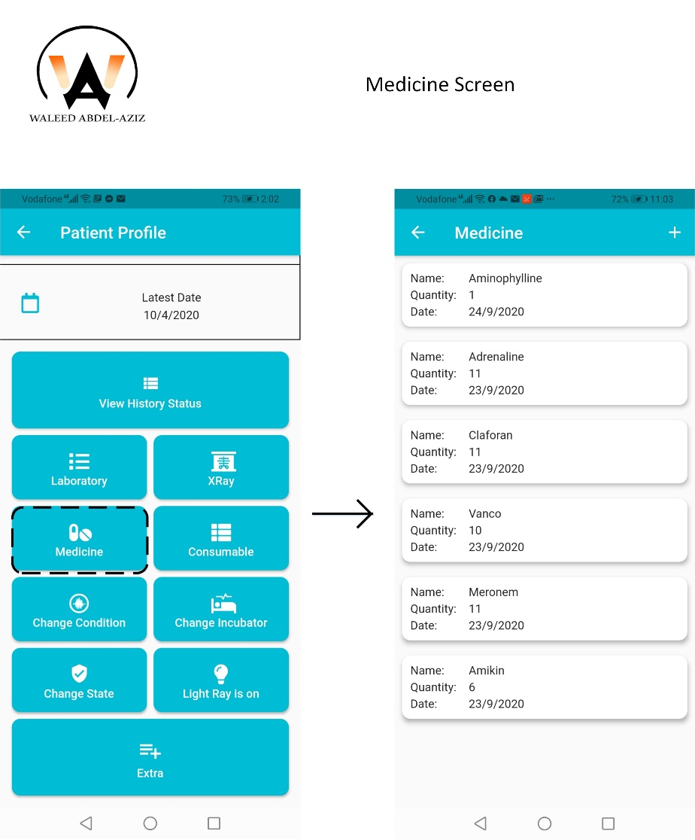
Doctor Screens (cont.)

Slide 77
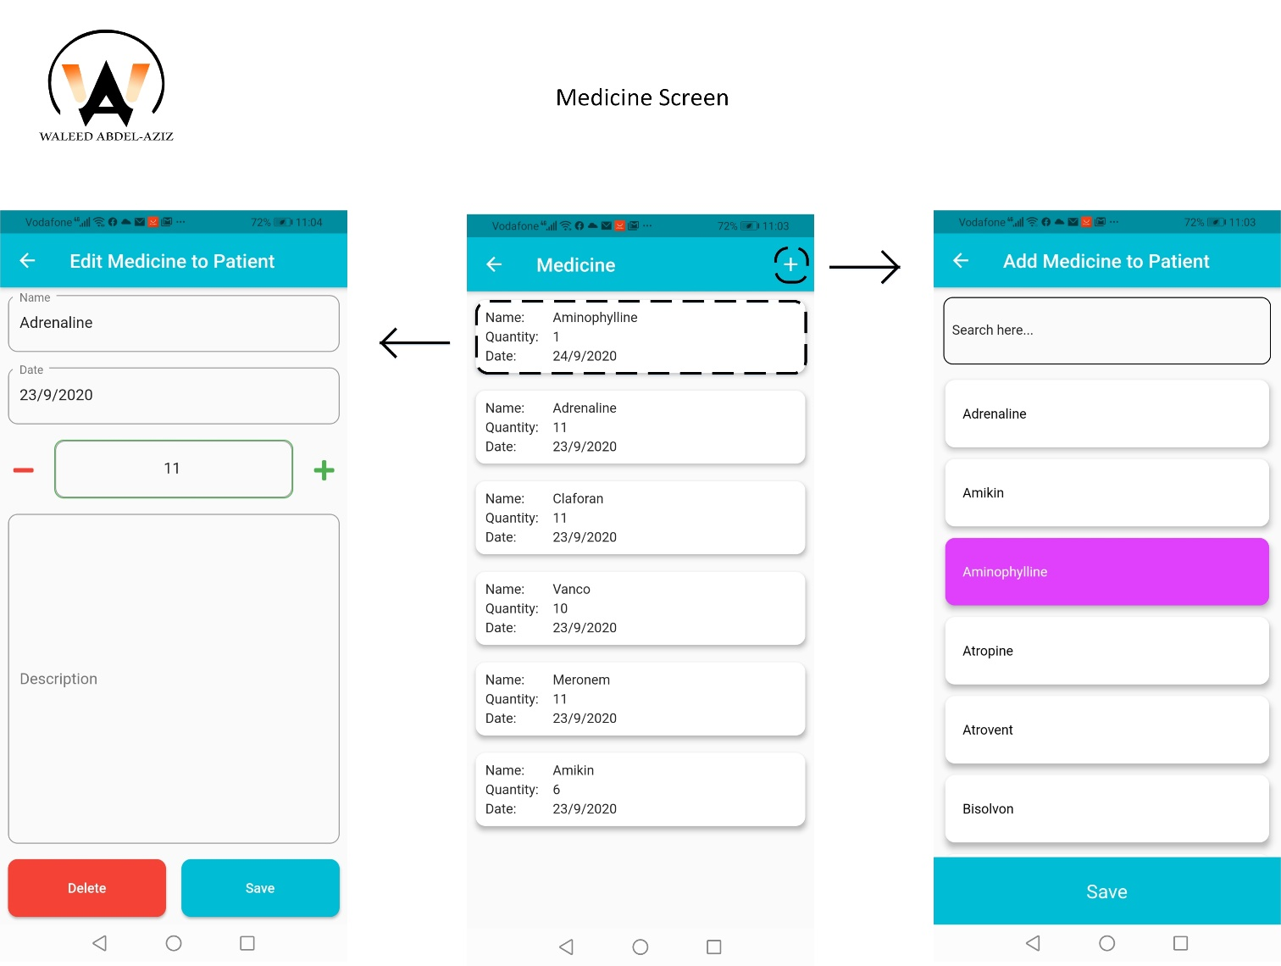
Doctor Screens (cont.)

Slide 78
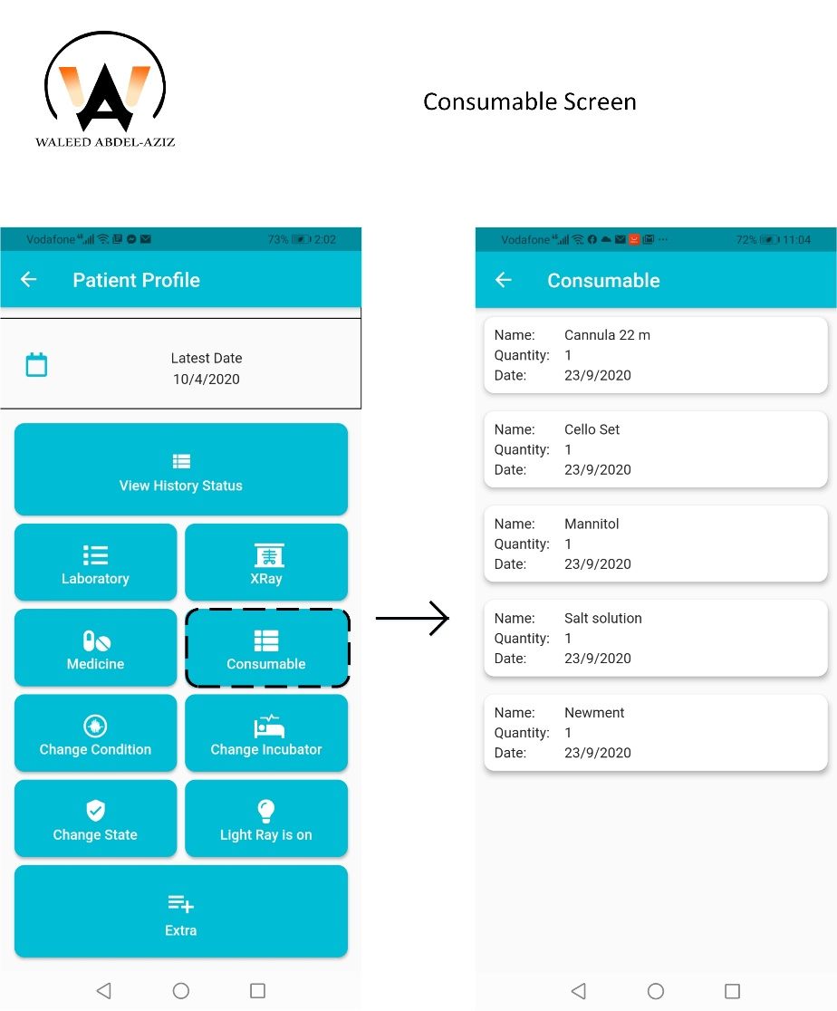
Doctor Screens (cont.)

Slide 79
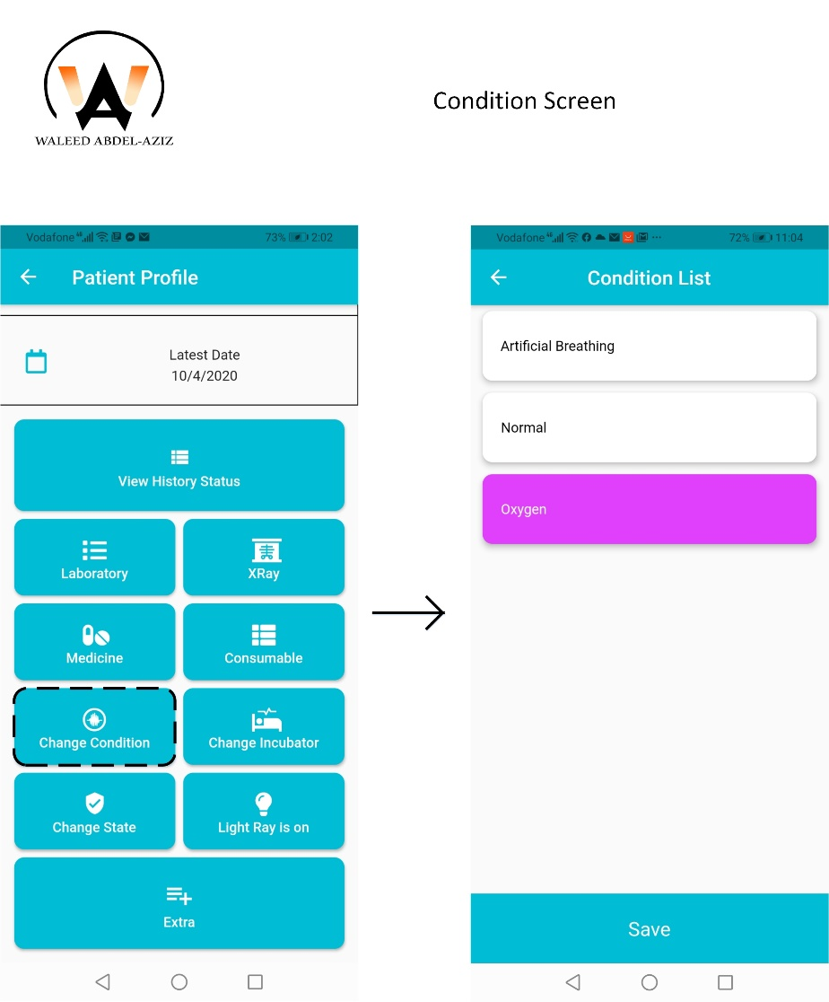
Doctor Screens (cont.)

Slide 80
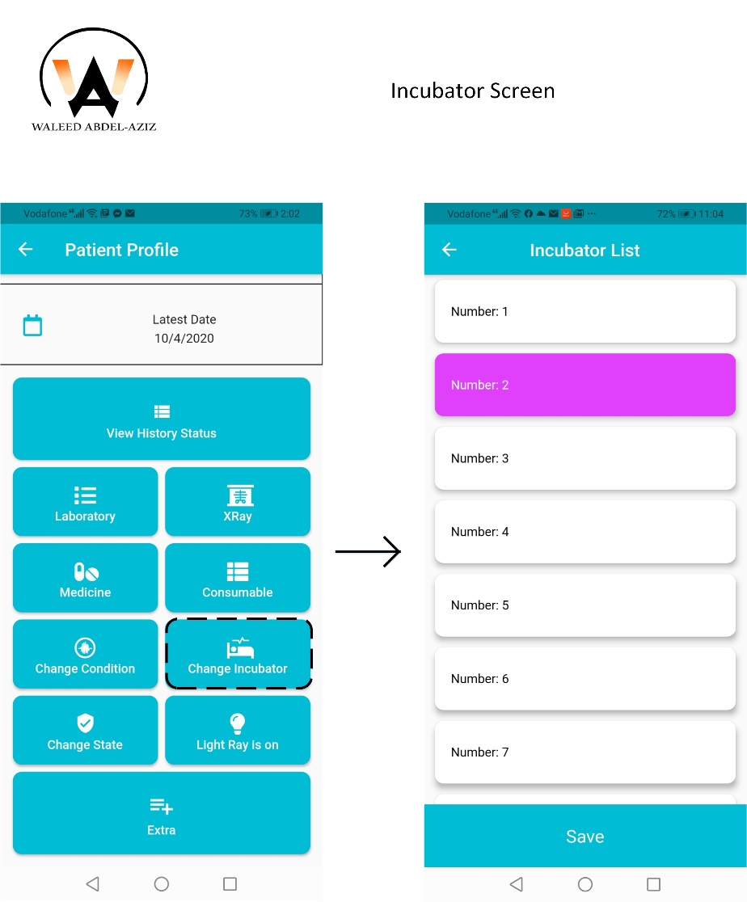
Doctor Screens (cont.)

Slide 81
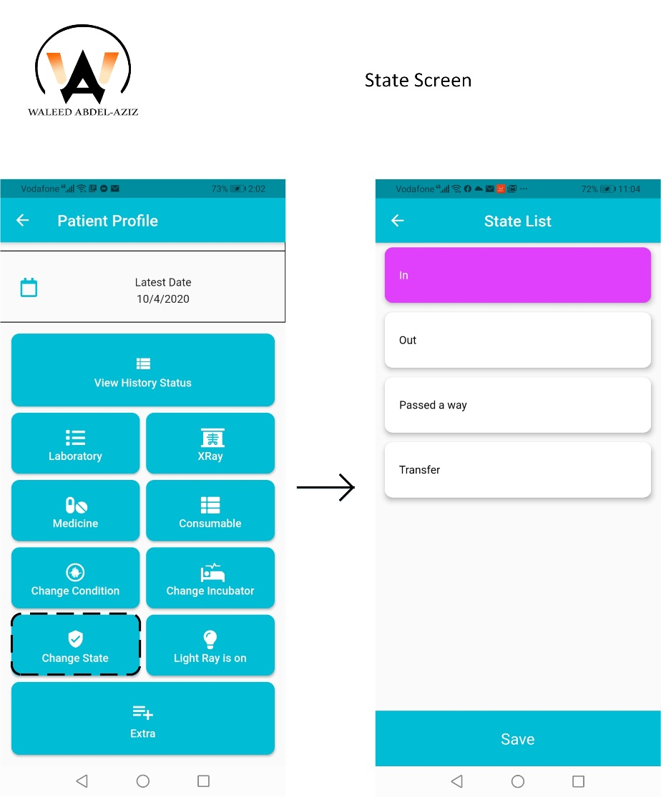
Doctor Screens (cont.)

Slide 82
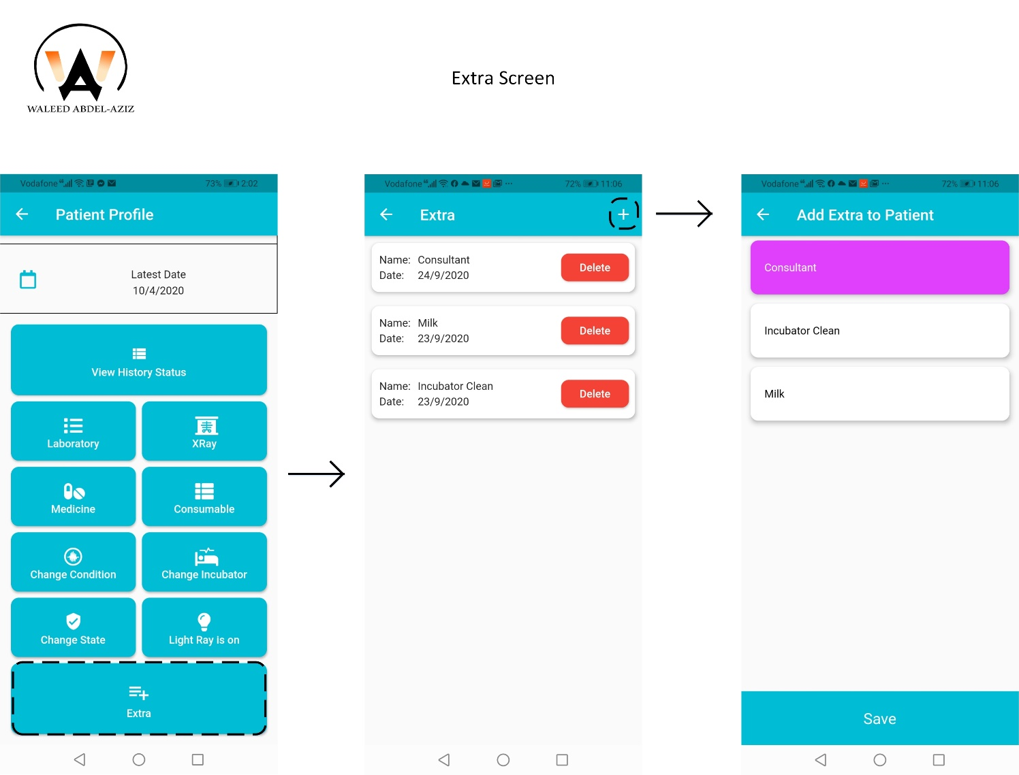
Doctor Screens (cont.)

Slide 83

Doctor Screens (cont.)

Slide 84

Doctor Screens (cont.)

Slide 85

Doctor Screens (cont.)

Slide 86
Screen Shoot
Startup Screen
Register Screens
Patient Screens
Doctor Screens
Nurse Screens
Accountant Screens

Slide 87
Nurse Screens

Slide 88

Nurse Screen (cont.)

Slide 89

Nurse Screen (cont.)

Slide 90

Nurse Screen (cont.)

Slide 91

Nurse Screen (cont.)

Slide 92

Nurse Screen (cont.)

Slide 93

Nurse Screen (cont.)

Slide 94

Nurse Screen (cont.)

Slide 95

Nurse Screen (cont.)

Slide 96

Nurse Screen (cont.)

Slide 97

Nurse Screen (cont.)

Slide 98

Nurse Screen (cont.)

Slide 99

Nurse Screen (cont.)

Slide 100

Nurse Screen (cont.)

Slide 101

Nurse Screen (cont.)

Slide 102

Nurse Screen (cont.)

Slide 103

Nurse Screen (cont.)

Slide 104
Screen Shoot
Startup Screen
Register Screens
Patient Screens
Doctor Screens
Nurse Screens
Accountant Screens

Slide 105
Accountant Screens

Slide 106

Accountant Screen (cont.)

Slide 107

Accountant Screen (cont.)

Slide 108

Accountant Screen (cont.)

Slide 109

Accountant Screen (cont.)

Slide 110

Accountant Screen (cont.)

Slide 111

Accountant Screen (cont.)

Slide 112

Accountant Screen (cont.)

Slide 113

Accountant Screen (cont.)

Slide 114

Accountant Screen (cont.)

Slide 115

Accountant Screen (cont.)

Slide 116

Accountant Screen (cont.)

Slide 117

Accountant Screen (cont.)

Slide 118

Accountant Screen (cont.)

Slide 119

Accountant Screen (cont.)

Slide 120

Accountant Screen (cont.)

Slide 121

Accountant Screen (cont.)

Slide 122

Accountant Screen (cont.)

Slide 123
Agenda
Introduction
Problem Definition
Proposed Solution
Main Goal(s)
Features
Ark Work
Navigation Screen (Block Diagram)
Screen Shot (GUI)
Hardware Specification (Mobile device)
Tools
Demo
Future Work

Slide 124
Hardware Specification (Mobile Device)
Huawei Y9S Specifications:
Display:
Size: 6.59 inches
Resolution: 1080 x 2340 pixels
Platform
OS: Android 9.0 PIE
CPU: OCTA Core
Memory
Internal Storage: 128
RAM:6 GB
Color: Breathing Crystal
Camera
Triple: 48 MP, 8 MP, 2 MP
Front: 16 MP

Slide 125
Agenda
Introduction
Problem Definition
Proposed Solution
Main Goal(s)
Features
Ark Work
Navigation Screen (Block Diagram)
Screen Shot (GUI)
Hardware Specification (Mobile device)
Tools
Demo
Future Work

Slide 126
Tools
Graphical User Interface (Mobile App) developed by Flutter
Backend
Middleware developed by Django (Python)
Database is developed on MySQL (Database Server)
Deployment on Heroku Cloud Server

Slide 127
Agenda
Introduction
Problem Definition
Proposed Solution
Main Goal(s)
Features
Ark Work
Navigation Screen (Block Diagram)
Screen Shot (GUI)
Hardware Specification (Mobile device)
Tools
Demo
Future Work

Slide 128
Demo

Slide 129
Agenda
Introduction
Problem Definition
Proposed Solution
Main Goal(s)
Features
Ark Work
Navigation Screen (Block Diagram)
Screen Shot (GUI)
Hardware Specification (Mobile device)
Tools
Demo
Future Work

Slide 130
Future Work
Work Online/Offline
Caching Data
Live Camera Implemented
Credit Card Payment Implemented

